Slide 1
Microtubules, Motors and Movement:
Cell Motility and the Cytoskeleton
John Cooper
Dept of Biochemistry & Molecular Biophysics
www.cooperlab.wustl.edu
jacooper@wustl.edu
November 14, 2019
Notes:
Movie of a white blood cell, a neutrophil (polymorphonuclear leukocyte), chasing and catching a bacterium. Surrounded by non-moving red blood cells. From a 16-mm movie taken in the 1950s by Dr. David Rogers at Vanderbilt.

Slide 2
Outline
I. Overview
II. Microtubules and Actin Filaments
Structure and polymerization
Dynamics
Nucleation centers
Associated proteins and assemblies
III. Motor Proteins
Actin - Myosins
Microtubules - Kinesins and Dynein
IV. Cell Machines based on Actin and Microtubules
V. Intermediate Filaments
Notes:
Outline of topics discussed today (and extending into the next lecture, fyi). We will end on time, and we will break in the middle.

Slide 3
Reading in Textbooks
Alberts et al., Molecular Biology of the Cell, 6th ed., 2014, Garland.
Chap. 16 - The Cytoskeleton.
Available as eBook, https://bit.ly/2AR19DR.
Lodish et al., Molecular Cell Biology, 8th ed., 2016, Macmillan.
Chaps. 17 & 18 - Microfilaments, Microtubules and Intermediate Filaments.
Available as eBook and hard copy, https://bit.ly/2Qy9Hog.
Pollard et al., Cell Biology, 3rd ed., 2016, Elsevier.
Section IX: Cytoskeleton and Cell Motility. Chaps 33-39.
Available as eBook and hard copy, https://amzn.to/2OwoAWC.
Notes:
Textbook chapters that relate to the material today. Perhaps you own or can borrow one of these books. Provides background for those for whom the material is very new, and provides extra information for those who are experts and interested.

Slide 4
Movies and Videos Online
Nikon Microscope Company
http://www.microscopyu.com/galleries/
Swept Field Confocal Digital Video Gallery
Live-Cell Imaging Cell Motility
Ted Salmon Lab at Chapel Hill
http://labs.bio.unc.edu/Salmon/salmonlabmovies.html
Am Soc for Cell Biology
Videos - News and Education, http://www.ibiology.org/
Webinars on Imaging - http://www.ascb.org/webinars/
Notes:
Cool movies and videos available online. Part of what makes the field of cell motility fun has always been watching things move.

Slide 5
Related Course Work
First-Year Lectures
Histology
Cell-cell Junctions in Epithelial Cell Biology
Muscle Cell Biology
Physiology
Muscle
MFM
Membrane Receptors and Signaling
Neuroscience
Axonal Transport and Neurofilaments
Second-Year Lectures
Hematology, Dermatology, Cardiology, Neurology
Notes:
How these lectures depend on and relate to other material you will see this year and next.

Slide 6
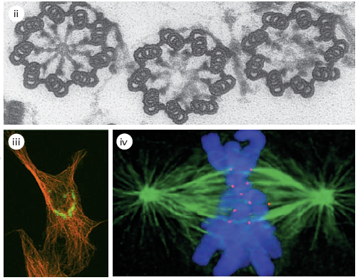
Microtubules
Rigid hollow cylinders of 25 nm diameter
In all eukaryotic cells (FtsZ in bacteria)
Involved in stable and dynamic structures
Notes:
Microtubules - fundamental facts. Participate in three major cellular machines pictured here - cilia / flagella, organelle transport, and mitotic spindle

Slide 7
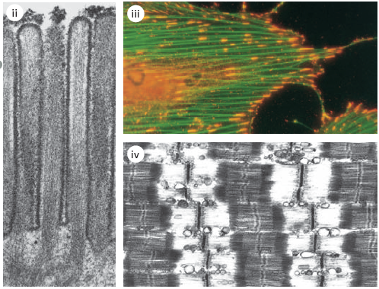
Actin
Flexible microfilaments of 5-10nm diameter
In all eukaryotic cells (MreB in bacteria)
Involved in stable and dynamic structures
Notes:
Actin - fundamental facts. Participate in three major cellular machines pictured here - microvilli of epithelial brush border, stress fibers for non-muscle cell contraction and adhesion, and the sarcomere of striated muscle.

Slide 8
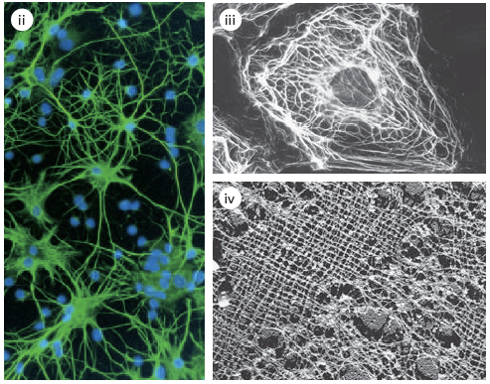
Intermediate Filaments (IF)
Rope-like
Expressed in most metazoans
Vimentin
Neurofilaments
Nuclear lamins
Notes:
Intermediate filaments - fundamental facts. Participate in three major cellular structures pictured here - neurofilaments in neuronal process, vimentin cage around nucleus, and lamin meshwork lining the inside of the nucleus.

Slide 9
II. Microtubules and Actin Filaments
Structure and polymerization
Dynamics
Nucleation centers
Associated proteins and assemblies
Notes:
Microtubules and Actin Filaments - common / related properties of the molecular mechanisms and cellular functions. Outline of what we will discuss.

Slide 10
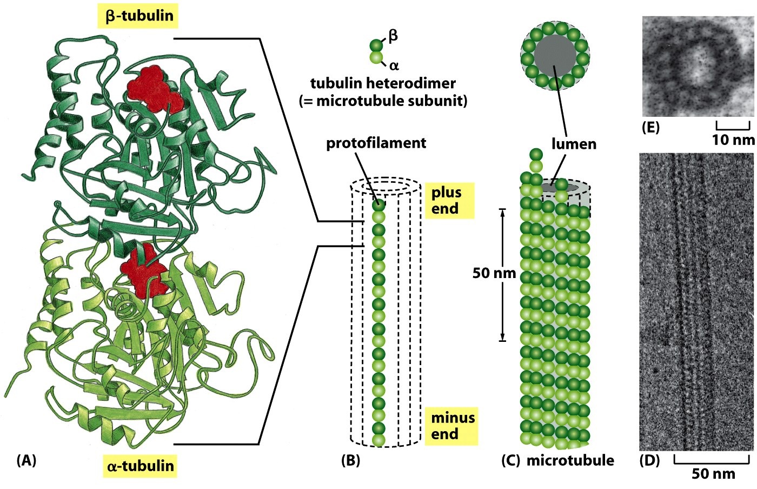
Microtubule Structure
Building block = heterodimers of α and β-tubulin
13 Protofilaments
Exchangeable
GTP
Same fold
40% ID
Non-exchangeable
trapped GTP
Notes:
Microtubules. Composed of the protein tubulin, an alpha/beta heterodimer. Assemble into hollow tube (hence the name). The tube has polarity - plus and minus ends.

Slide 11
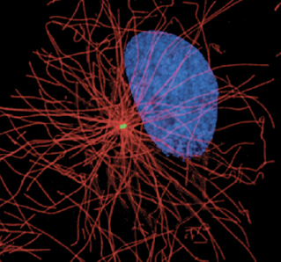
Microtubule Structure
Filament polarity conferred by alpha/beta heterodimer
α
β
α
β
Centrosome
(Minus End)
Plasma Membrane
(Plus End)
+
+
+
+
+
+
+
+
+
Notes:
Microtubule polarity - minus ends at center of cell. Tethered to Centrosome. Generic name is Microtubule Organizing Center - MTOC. Plus ends extend to cell periphery. Note arrangement of alpha and beta subunits of tubulin heterodimer.

Slide 12
Microtubules: In vivo dynamics
Notes:
Microtubules are very dynamic in cells, growing and shrinking on the time scale of seconds. Phases of growth and shrinkage. Hit the plasma membrane.

Slide 13
Microtubules: Polymerization Dynamics
k_{on}
Polymer + One Subunit
Polymer/Subunit
k_{off}
Rate of subunit addition = k_{on} x [S]
Rate of subunit loss = k_{off}
As the polymer grows, subunit concentration [S] diminishes
until it reaches a so-called “critical concentration” [Cc] for which …
Rate of subunit addition = Rate of subunit loss
k_{on} x [Cc] = k_{off}
[Cc] = k_{off}/ k_{on}
Notes:
Mathematical expressions describing the chemical rate equations for how Microtubules grow and shrink. Subunits (tubulin heterodimers) add or leave the Microtubule, but ONLY from the ends, NOT the sides.

Slide 14
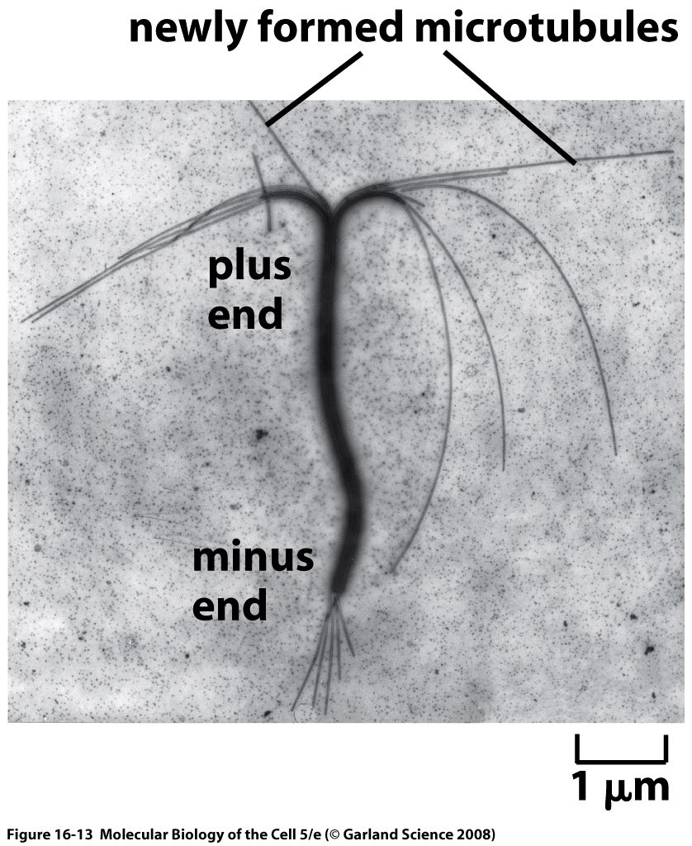
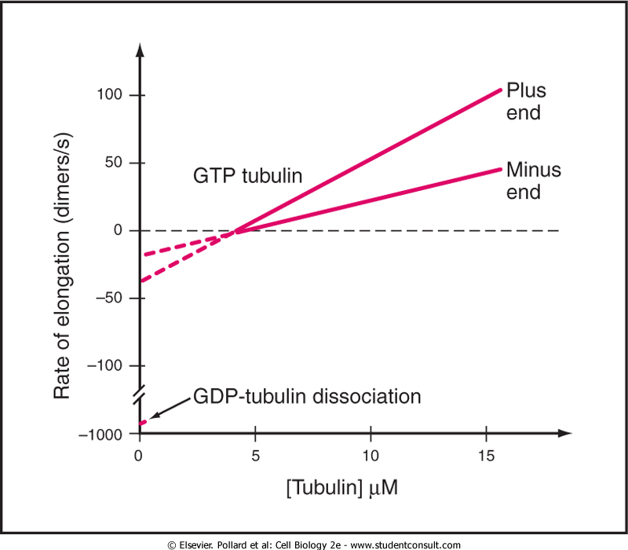
Microtubules: Polymerization Dynamics
Minus
end
Plus
end
k_{on}
k_{off}
Slower
growth
Faster
growth
k_{off}
k_{on}
Notes:
Microtubule plus and minus ends grow and shrink at different rates. Experiments can measure the rate constants.

Slide 15
Microtubules: Dynamics
Enzymatic activity of tubulin catalyzes hydrolysis of bound GTP to GDP
Minus
end
Plus
end
GDP-Tubulin
Lower rate of
subunit addition
GTP-Tubulin
GTP-Tubulin
Minus
end
Plus
end
GDP-Tubulin
GTP-Tubulin
Hydrolysis catches up with the minus end
Notes:
Tubulin has bound nucleotide - GTP or GDP. Subunit in solution has GTP, exchanges with free GTP. After adding to Microtubule, the GTP hydrolyzes to GDP, and the nucleotide does NOT exchange with free GTP.

Slide 16
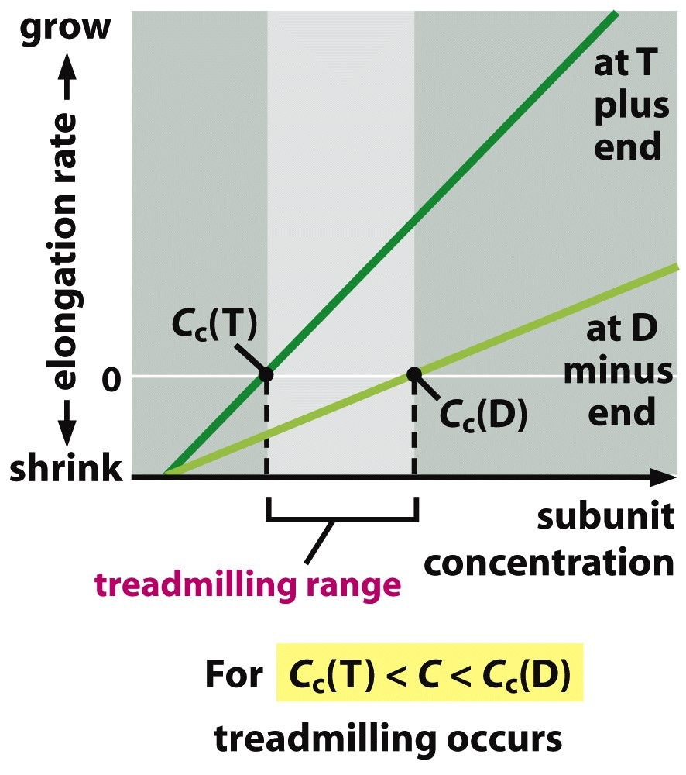
Microtubules: Dynamics - “Treadmilling”
Minus
end
Plus
end
GDP-Tubulin
GTP-Tubulin
GDP tubulin leans toward disassembly
k_{off} GDP tubulin >> k_{off} GTP tubulin
Cc(D)>>Cc(T)
For certain concentrations of subunits, minus end will shrink while plus end will elongate
=> “Treadmilling”
Notes:
Important implication of GTP hydrolysis. Microtubules with GTP subunits tend to polymerize, Microtubules with GDP subunits tend to depolymerize. The end is the critical location.

Slide 17
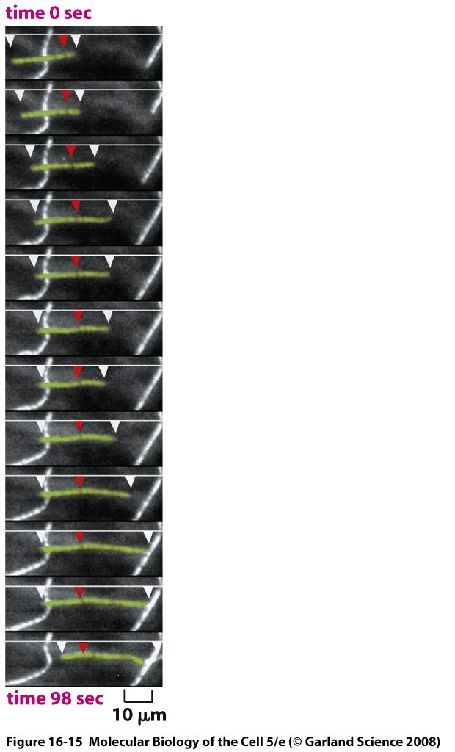
Microtubules: Dynamics - “Treadmilling”
Shrinking at
Minus end
Elongation at
Plus end
“Fixed point”
Notes:
Implication => “Dynamic Instability” of Microtubules. Plus ends grow slowly for a period of time, then switch and shrink rapidly. Amazing finding that shocked the field at the time of its initial observation. Individual Microtubules in solution or in a cell all behave independently of each other.

Slide 18
Microtubules: Dynamics
“Dynamic Instability” = Growth and Shrinkage Alternate with Stochastic Transitions, termed “Catastrophe” and “Rescue”
0.1μμ περ second
1000 dimers or 0.5 μμ περ second
every ~70 seconds
every ~20 seconds
Notes:
Dynamic Instability. Growing phase ends with “catastrophe” - pause followed by shrinking. Shrinking phase ends with “rescue” - pause followed by growth. Molecular basis for catastrophe and rescue, especially the pauses, is not properly understood - active area of research.

Slide 19
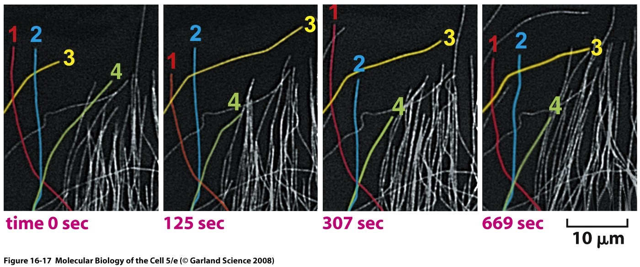
Microtubules: Dynamic Instability
Notes:
Examples of Dynamic Instability in cells.

Slide 20
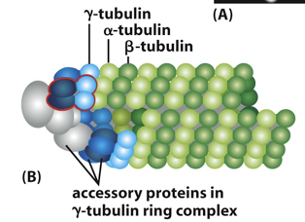
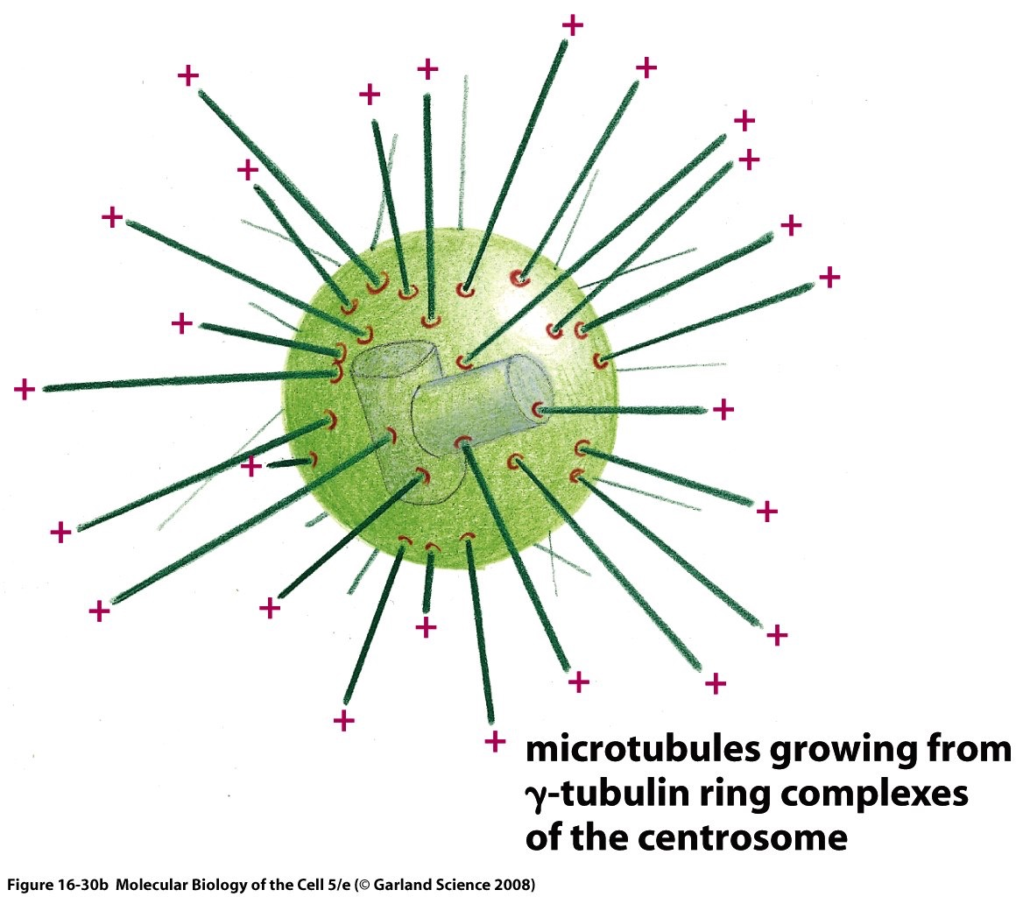
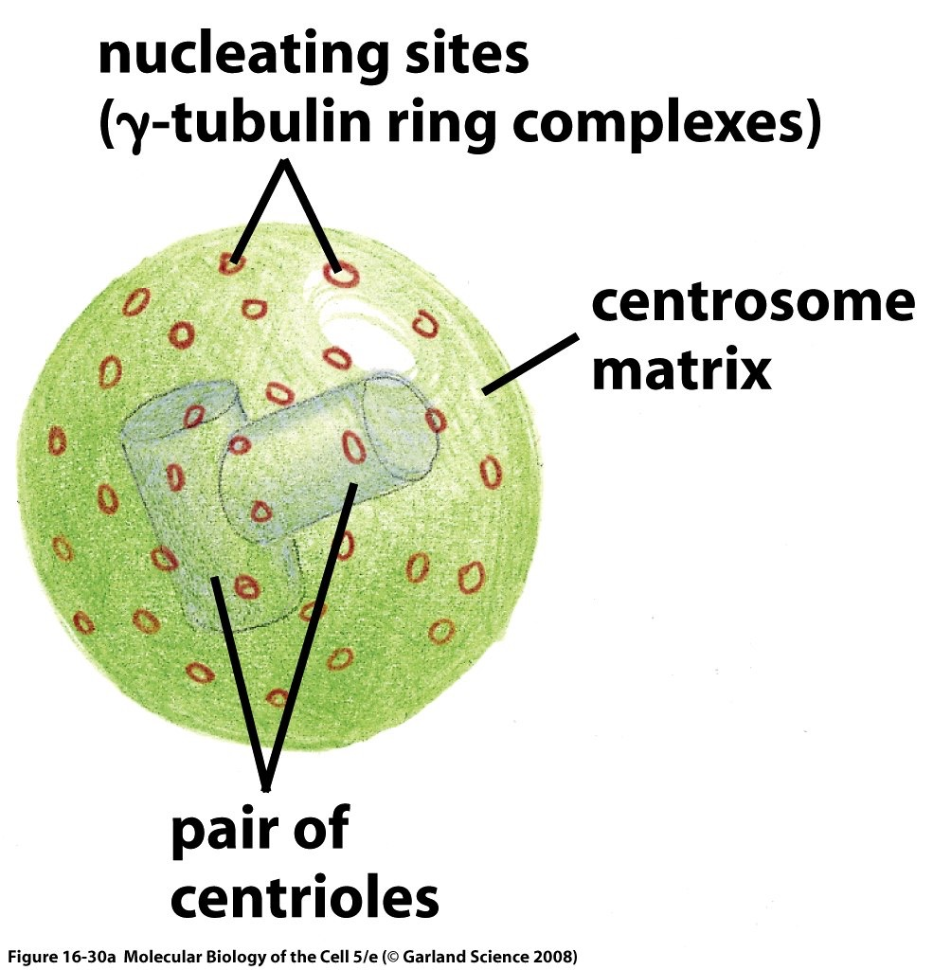
Microtubules: Nucleation by Centrosome
Individual microtubules minus ends created by Γαμμα-Tubulin Ring Complex, “γ-TuRC”
Notes:
Centrosome function - create (nucleate) new Microtubules from subunits. Hold onto the minus ends, while the plus ends grow out. Uses an unusual form of tubulin - gamma.

Slide 21
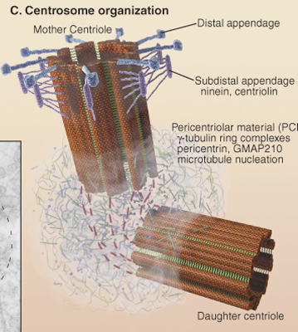
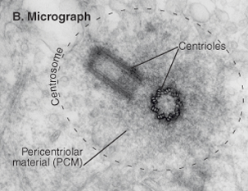
Microtubules: Centrosome
2 perpendicular centrioles (Microtubules + other proteins)
Pericentriolar amorphous material
Notes:
Centrosomes are composed of two “centrioles” surrounded by amorphous “pericentriolar material (PCM).” Centrioles are composed of microtubules, in a highly stereotypical structure. Minus ends of Microtubules are nucleated by the amorphous PCM.

Slide 22
Microtubules: Centrosome & Centriole Duplication
Notes:
One cell has one (and only one) centrosome, which has two centrioles inside it. During cell division, the centrosome duplicates itself. Each of the centrioles stays intact, and each of these “mother” centrioles gives rise to a new “daughter” centriole.
Example of “epigenetic” information - daughter centriole assembled from new components. On their own, this would take days to years to occur. Instead, it happens within seconds because (in some mysterious way), the structure of the mother centriole is read and followed.

Slide 23
Microtubules: Drugs that affect dynamics
Taxol
Bark of the Pacific yew tree “Taxus brevifolia”
Breast cancer and other solid tumors
Mechanism uncertain
Colchicine
Autumn crocus
Gout (from 1500 BC), other inflammatory disease
Vincristine / vinblastine
Vinca plants
Childhood leukemia
Inhibits mitosis
Notes:
Drugs that target Microtubules. Long history, diverse disease, many natural products.

Slide 24
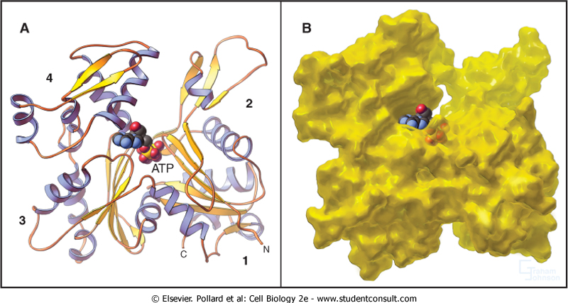
Actin
Subunit is a monomer that binds ATP
ATP-binding cleft towards the Pointed / Minus (-) end
Notes:
Actin. Subunit is a monomer. Each one binds one ATP. How does that contrast w/ Microtubules?

Slide 25
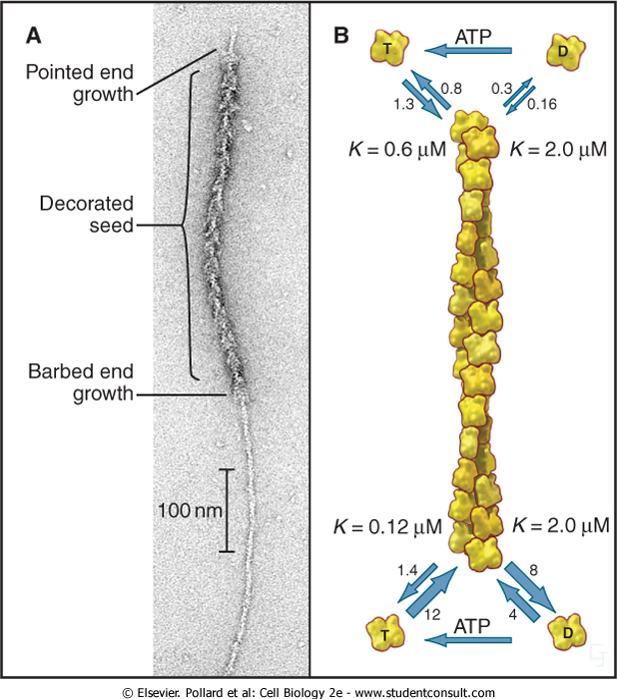
Actin
Flexible filament composed of two protofilaments
Pointed end
= Minus end
Barbed end
= Plus end
Faster Growth at Barbed (plus) End
Notes:
Actin subunits assemble into actin filaments. Subunit arrangement has helical symmetry, but not a tube. Resembles two strands of beads on strings. Aside - actin filaments are sometimes called “microfilaments” in cells, when one is not sure if they are composed of actin.

Slide 26
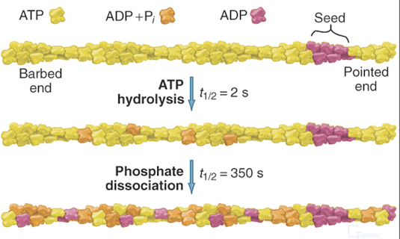
Actin: Dynamics
ATP hydrolysis occurs at random time (first-order decay)
Notes:
Actin monomers in solution have bound ATP, which exchanges with free ATP. After adding to the filament, the ATP hydrolyzes to ADP, after a short while. The nucleotide bound to the subunit in the filament does NOT exchange. How does this compare to Microtubules?

Slide 27
Actin: Nucleation
Actin filaments often nucleated near membranes
Actin-related-protein (Arp) 2/3 complex is one major nucleator
Notes:
Spontaneous nucleation of a new filament from free subunit is a rare, for actin and Microtubules. Several subunits have to find each other and stick together. Actin filaments, like Microtubules, are usually nucleated by another molecule. One is Arp2/3 complex, discovered by a graduate student doing an experiment that her PhD thesis advisor did not want her to do and which made no sense for several years. Arp2/3 nucleates and holds onto the minus (pointed) end; the free plus (barbed) end grows. How does this compare to Microtubules?

Slide 28
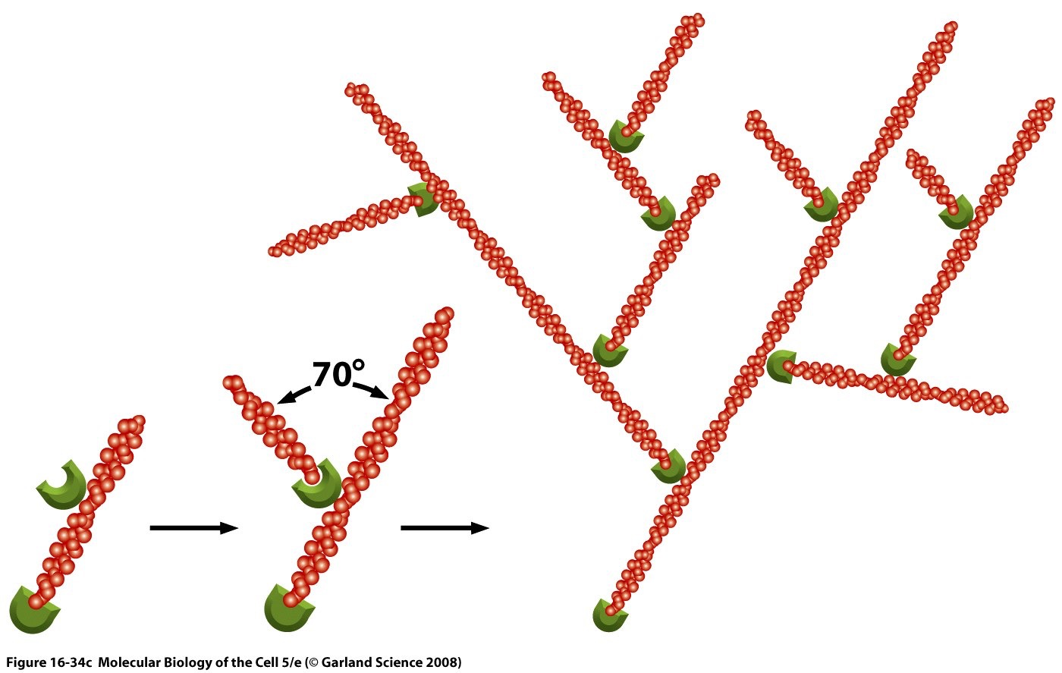
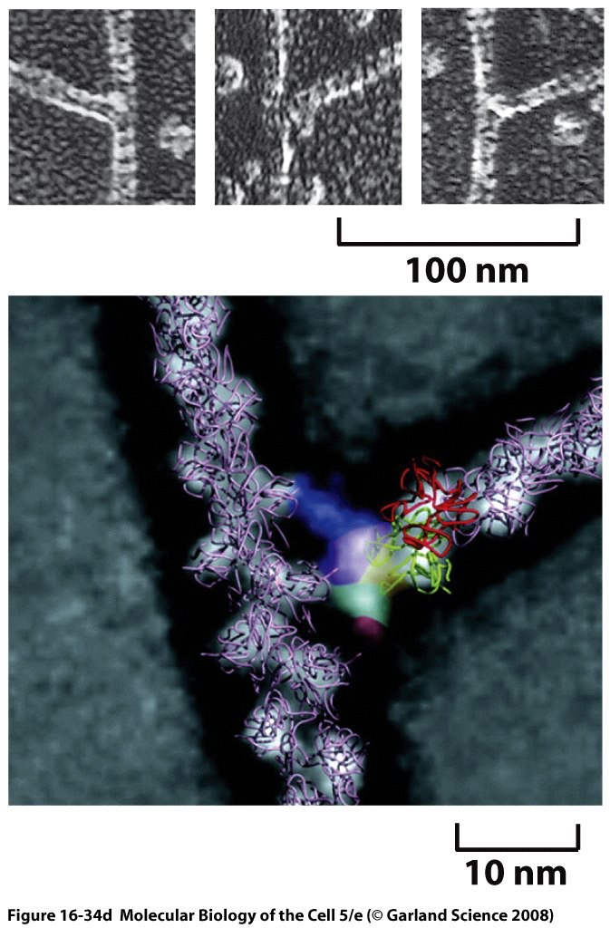
Actin: Branching Network of Filaments created by Arp2/3 Complex
Notes:
Arp2/3 complex also binds to the side of an existing (mother) filament, before it creates (nucleates) a new daughter filament. Leads to creation of a branching meshwork of filaments. Called “dendritic nucleation.” Discovered with pure proteins, and then found to exist in cells.

Slide 29
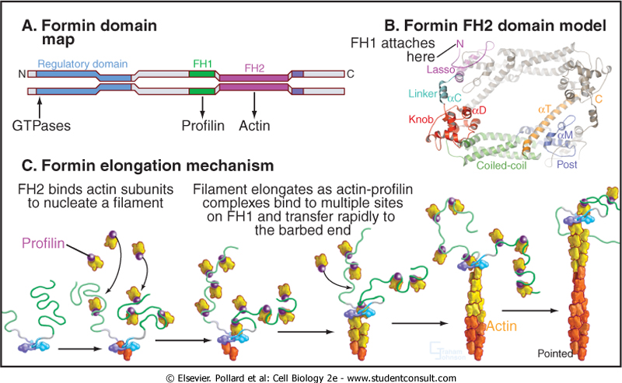
Actin: Nucleation and Elongation by Formins
Formin dimer nucleates - but NO branch between actin filaments
In cells, multiple formins -> different structures with different functions
Notes:
Formins are another important class of actin nucleators. Collect subunits and starts a new actin filament, but then holds onto the barbed (plus) end. The pointed end is free. No branches.
**Weird and confusing thing** - the barbed end can grow or not, depending on which one of ~15 types of formin is present.

Slide 30
Actin: Nucleation and Elongation by Formins
Notes:
Animation illustrating how formin binds to barbed end while allowing new actin subunits to add.

Slide 31
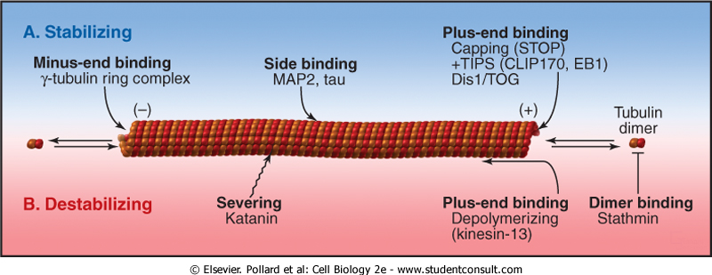
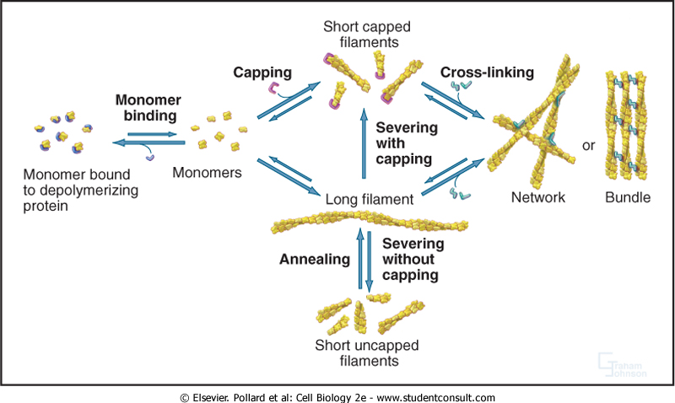
Microtubule- and Actin-associated proteins
Monomer binding proteins (kinetics modification)
Polymer tip-associated proteins (steric modification)
Polymer lateral binding (stability and mechanics)
Polymer severing
Microtubules
Actin
Notes:
Associated proteins. Every cell has actin and tubulin, which is almost identical from cell to cell. Microtubules and actin filaments both have a diverse and distinct array of proteins associated with them. In different cells at different times, the identity of the associated proteins is what gives actin and Microtubules their cell-specific functions.
The sheer number and the diversity of their functions can be overwhelming. We are only going to consider a few key ones, as illustrations.

Slide 32
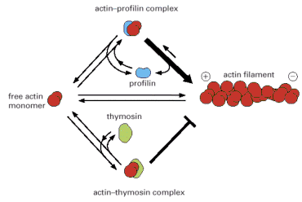
Monomer-binding Proteins
Actin: Thymosin/Profilin
In cells, ~50% of actin in filament, 50% (50-200 μM) unpolymerized, but Cc ATP-actin <1 μM). Other proteins bind and sequester actin monomers.
Thymosin: blocks polymerization of G-actin at either + or - end
Profilin: Binds + end of G-actin and promote polymerization at + end only
Notes:
In cells, half of the actin is not polymerized (not in the form of filaments). Based on the properties of pure actin, essentially all of the actin should be polymerized. The cell keeps half of its actin as subunits in a non-polymerized state. Used these subunits as a buffer or a pool available to grow new filaments when and where they are needed. Thymosin and profilin are two small proteins that bind to actin subunits, 1:1.
Thymosin is simple. When bound to actin, that actin subunit cannot polymerize. Period.
Profilin is complicated. When bound to actin, that actin subunit can add to the barbed end but not the pointed end. Think about the implications for cells.

Slide 33
Monomer-binding Proteins
Microtubules: Stathmin
Same principle as thymosin for actin. Binds two tubulin dimers and slows down polymerization rate. Leads to increased frequency of catastrophe because GTP hydrolysis “catches up” with end.
Notes:
Stathmin binds tubulin subunits, preventing polymerization. Analogous to thymosin.

Slide 34
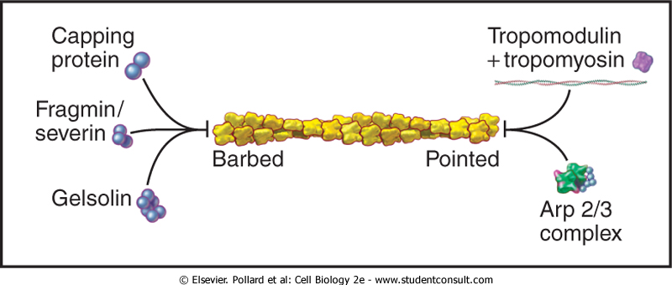
End-binding Proteins - Actin
Gelsolins
-bind to side and barbed (+) end of filaments
-block association or dissociation of actin subunit
Heterodimeric capping proteins (CapZ):
-Two subunits bind to barbed (+) end
-Also present on barbed (+) end of actin filaments in Z disk
Tropomodulin:
-caps pointed (-) end of stable actin filaments in cooperation with tropomyosin
Notes:
Actin filament ends can be bound by several different proteins. We saw already that Arp2/3 complex binds the pointed end. Pointed ends can also be bound by tropomodulin, which works together with tropomyosin. We know a lot about tropomyosin and tropomodulin from research on striated muscle, but the exist in all cells.
At the barbed ends, two different types of end-proteins are “capping protein” (this seemingly generic name is the specific name, unfortunately) and “gelsolin.” (Above, fragmin/severin is type of relative of gelsolin.)
In sarcomeres of striated muscle, the barbed ends of the actin filaments are all bound to the “Z disc.” Those ends are all bound by capping protein, which is then often called “CapZ.” Think about muscle physiology - why is this important?

Slide 35
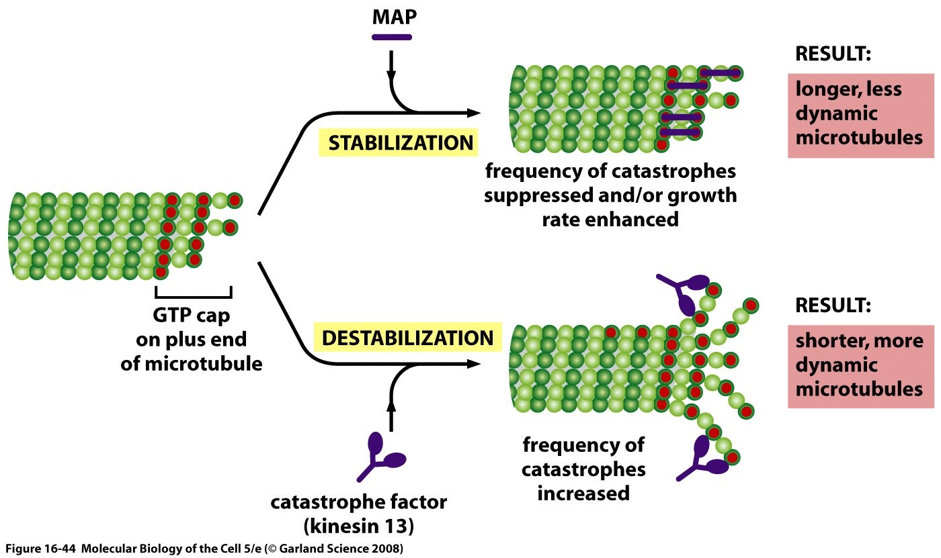
End-binding Proteins - Microtubules
MAPs: microtubule-associated proteins
Kinesin-13: promotes catastrophe
Notes:
Microtubule plus-end-binding proteins can either stabilize or destabilize those ends. Increases or decreased the rates of catastrophe and rescue, which is critical for dynamic instability and how Microtubules function in cells.

Slide 36
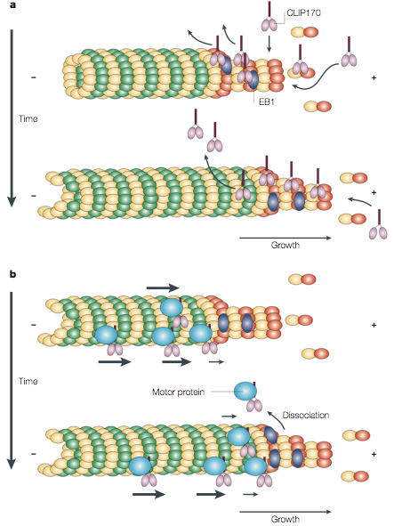
End-binding Proteins - Microtubules
Plus-end tracking proteins (+TIPS): CLIP170 and EB1
Deposition by
Treadmilling
EB1 - GFP
Deposition by
motor proteins
CLIP170 - GFP
Notes:
Some plus-end-binding proteins ride along with the plus end while it grows and shrinks. Provides a mark and allows the plus end to have specific interactions that the all the rest of the Microtubules does not have. Why might this be useful for a cell?

Slide 37
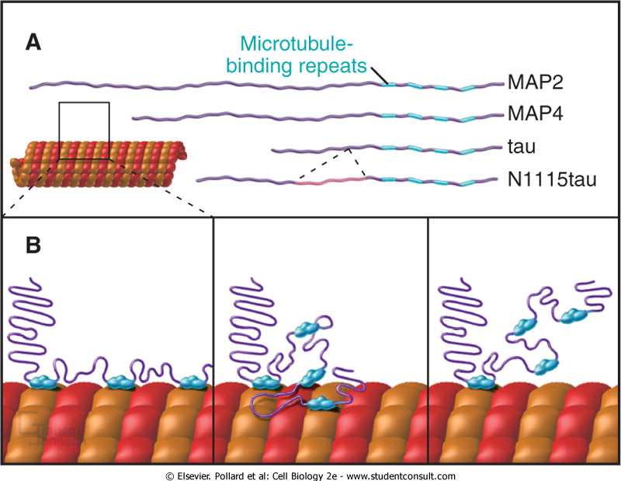
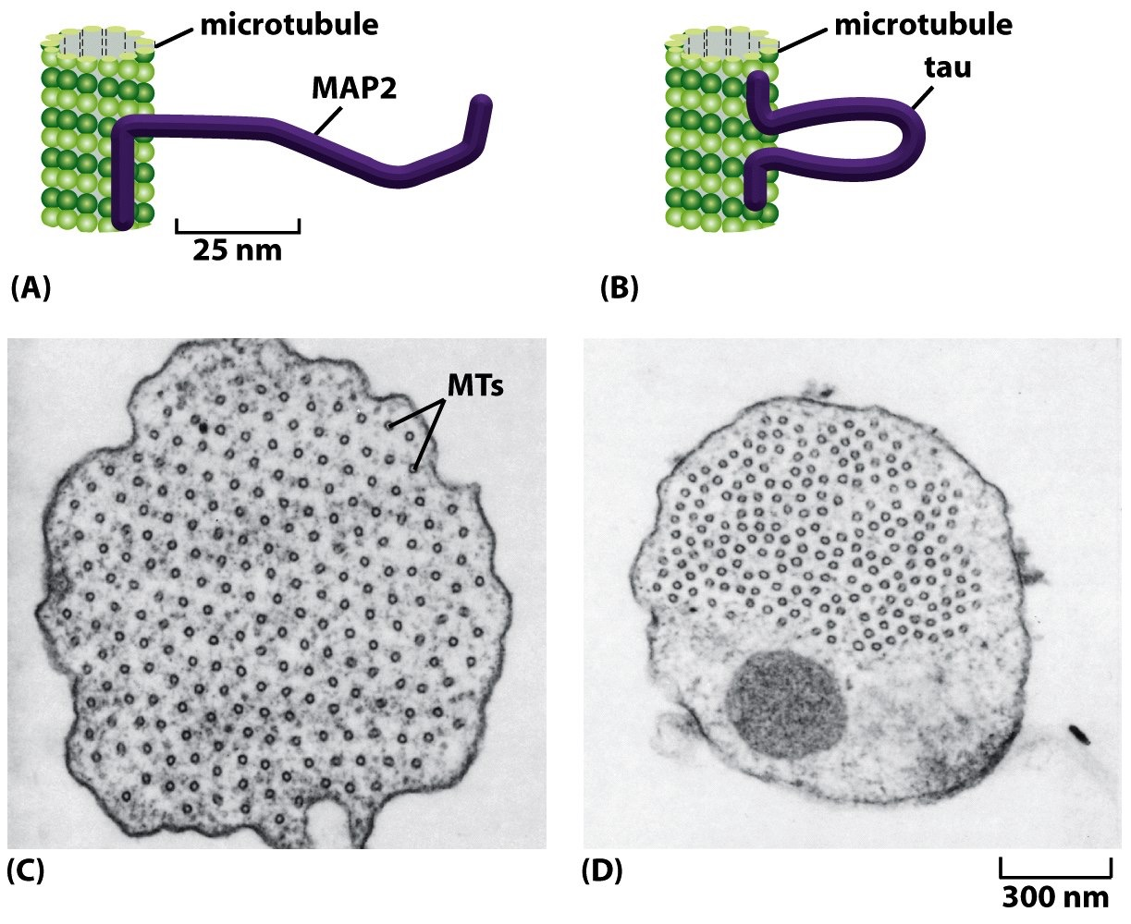
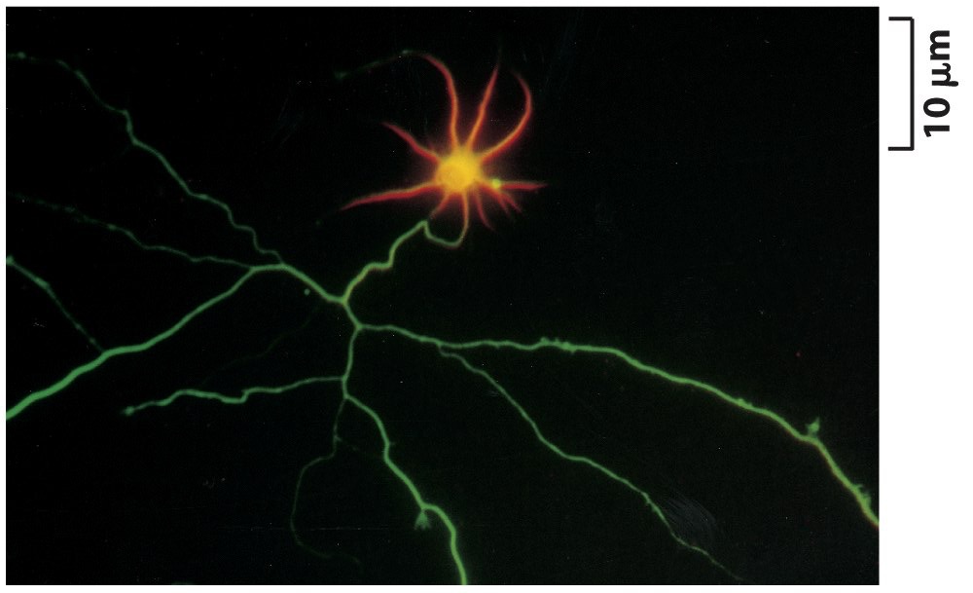
Side-binding Proteins - Microtubules
Tau and MAP2 (neurons, brain)
XMAP (ubiquitous)
MAP2
Tau
Notes:
Microtubule side-binding proteins decorate the lengths of Microtubules and allow them to have distinct properties or make other interactions. Extend out from the surface and create spacing, for one thing. What else? Not clear - much to learn. Tau is implicated in many disease where neurons die.

Slide 38
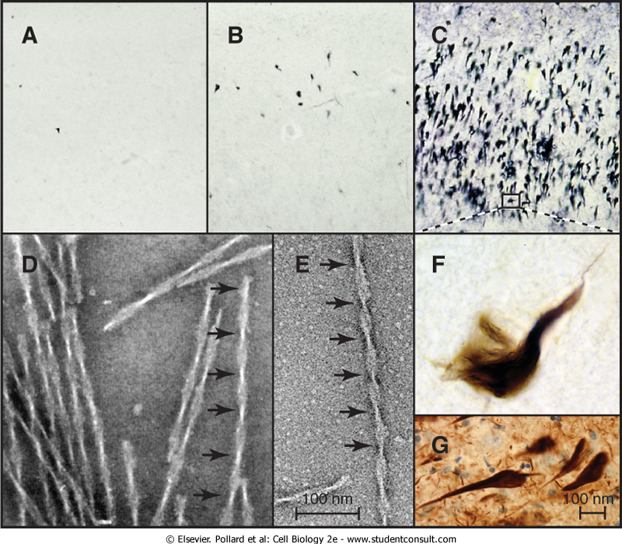
Tau and Alzheimer Disease (AD)
Tau forms intracellular paired helical filaments. Aggregate into neurofibrillary “tangles.” Tangle number correlates with disease severity.
Tau mutations: associated with rare cases of dementia.
Tau phosphorylation dissociates tau from Microtubules. Hyperphosphorylated tau then proteolytically fragmented and aggregates.
Notes:
Tau has been implicated in Alzheimer Disease, which is a huge problem and challenge for our society. Tau gets phosphorylated, comes off the Microtubules, and then aggregates. Large aggregates are seen in the light microscope and are called “tangles.” They correlated with disease - but how and why?

Slide 39
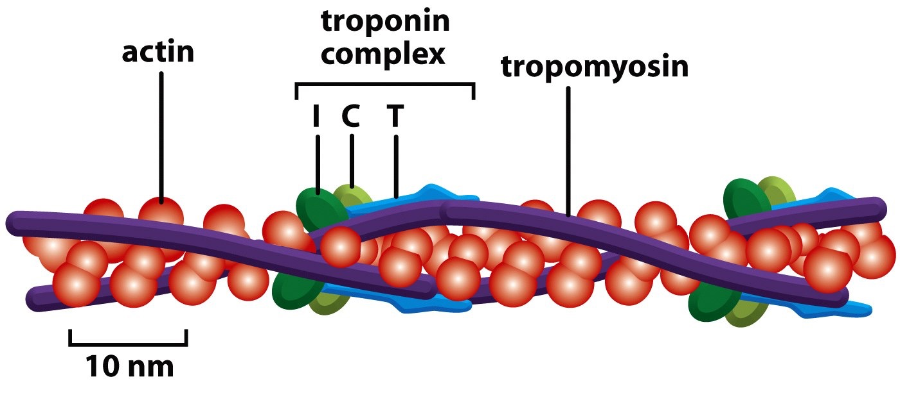
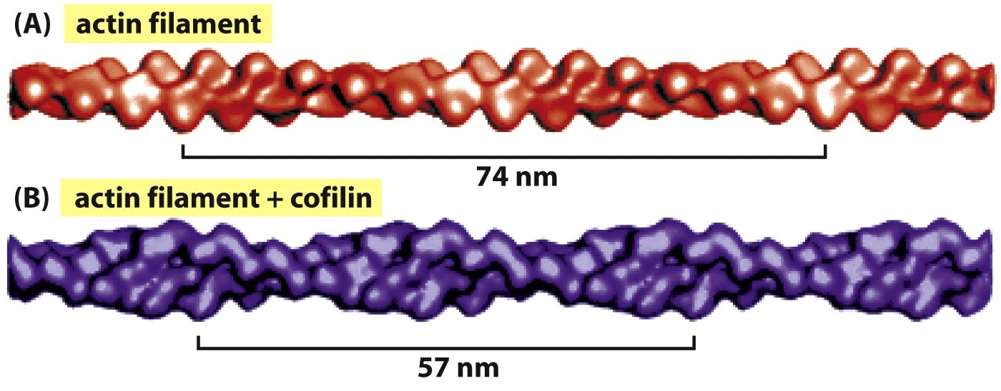
Side-binding Proteins for Actin Filaments
Tropomyosin (muscle and non-muscle)
Increase tensile strength of actin - stronger filaments
Cofilin
Increase twisting of protofilaments - promotes severing
Notes:
Two important actin filament side-binding proteins are tropomyosin and cofilin. Tropomyosin acts like glue, making the filament stronger and keeping the subunits from falling off the ends. Cofilin twists the filament, making it more prone to break. Cells are constantly creating new filaments and breaking down old ones; carefully regulated disassembly is necessary for careful regulation of assembly.

Slide 40
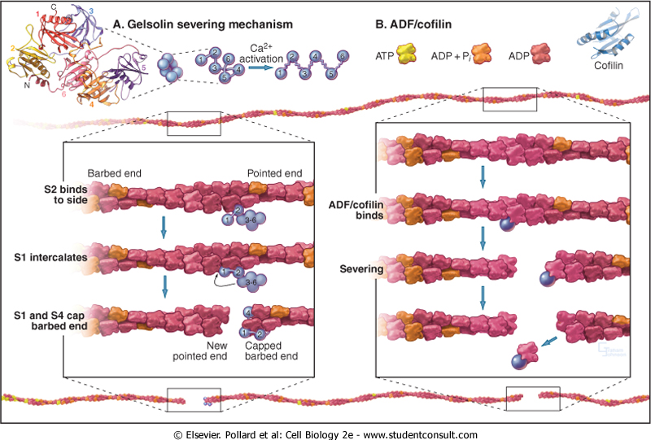
Actin Filament Severing Proteins: Gelsolin and Cofilin
Notes:
To promote disassembly, some side-binding proteins can cause a filament to break in the middle. Gelsolin, mentioned previous as a barbed-end capping protein, holds on to the barbed end after it breaks the filament. Cofilin breaks and then leaves, leaving the end free. Gelsolin needs Ca2+ to work - lots of it. What good is that?

Slide 41
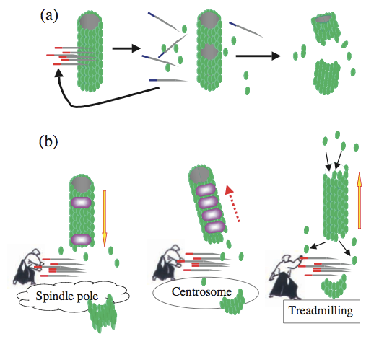
Microtubule Severing by Katanin (AAA ATPase)
Notes:
Microtubule severing protein is katanin. (Google that name).

Slide 42
Higher-order Ultrastructural Organization
How do cells organize microtubules and actin filaments into large structures and nano-machines?
Notes:
Microtubule and Actin associated proteins are the first step for how cells assemble these tubes, ropes and guy-wires into useful large structures and nano-machines.

Slide 43
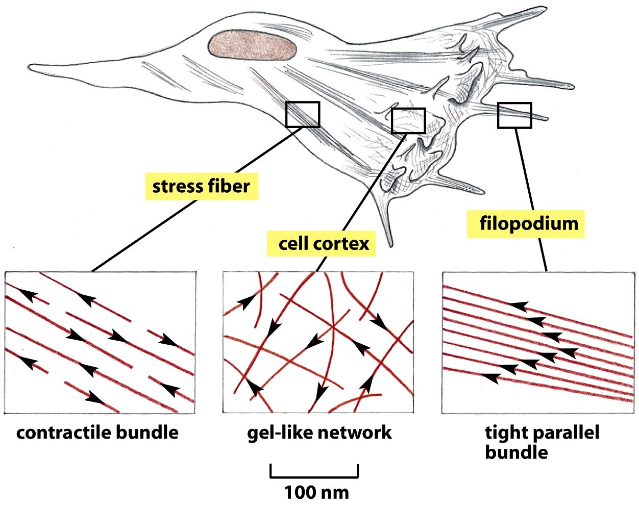
Actin: Bundles or Gel-like Networks
Cross-linking by specific proteins
Notes:
Actin filaments are organized into different types of structures in different parts of the cell, for different purposes. Changes over time, depending on what the cell wants to do.

Slide 44
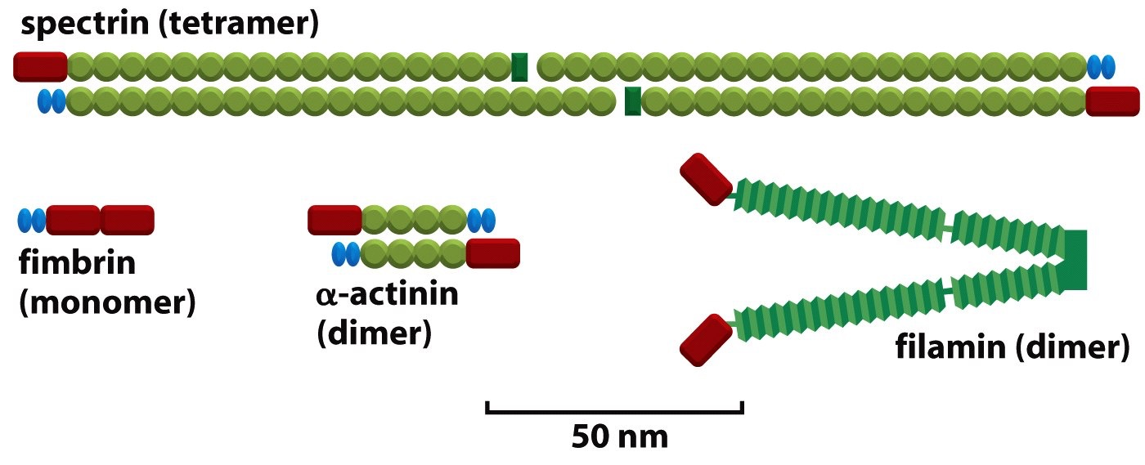
Actin: Filament-Bundling Proteins
200nm
14nm
30nm
Notes:
One category of actin-associated proteins bind to the sides of the filaments and cause the filaments to bundle together. Much stronger than one filament alone.

Slide 45
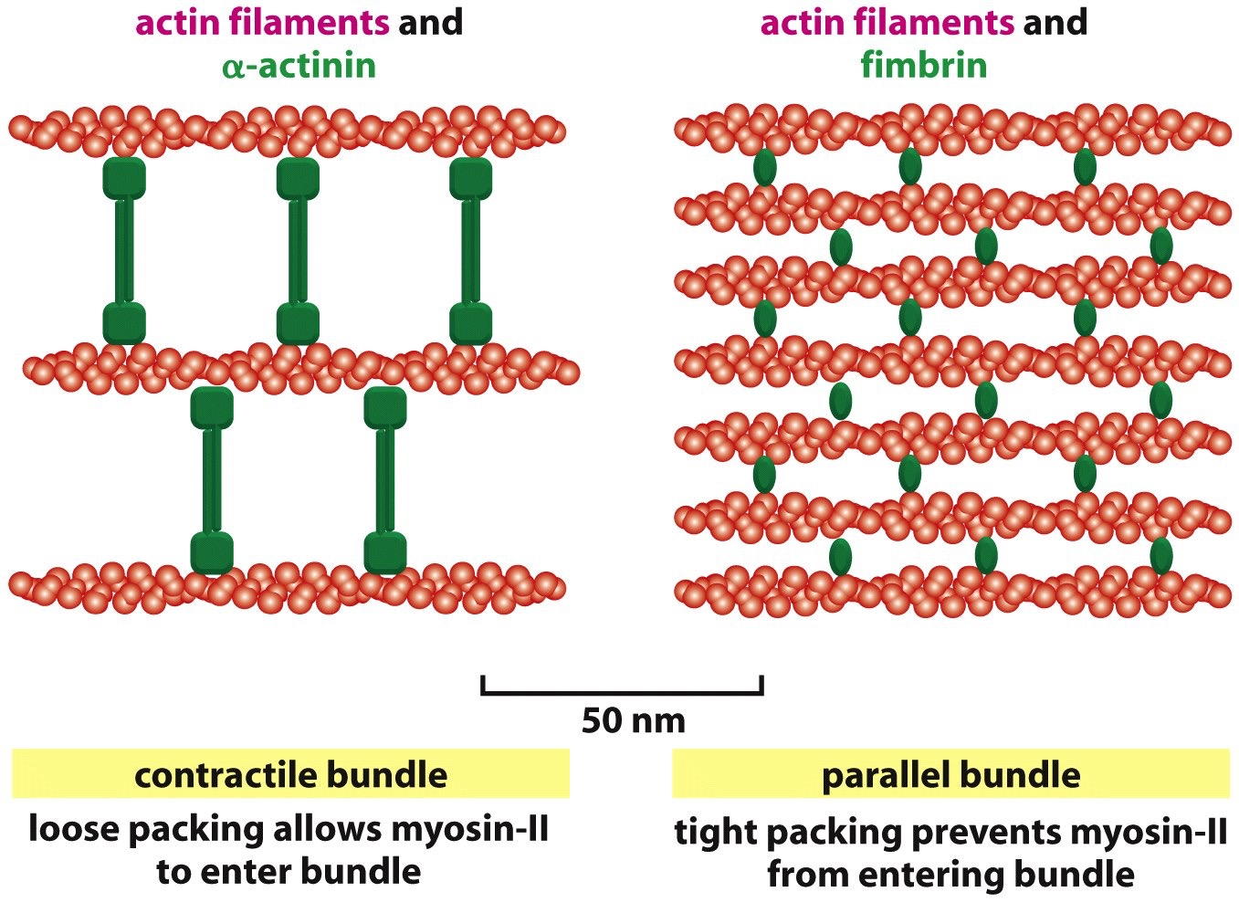
Actin: Bundles of Filaments in Cells
Contractile Bundles
“stress fibers” of non-muscle cells
Parallel bundles
microvilli and filopodia
Notes:
Bundles with filaments of mixed (opposing) polarity are capable of mediating contraction, like a miniature sarcomere. Bundles with filaments of the same polarity are often tightly packed and serve more structural roles, such as microvilli on the surface of epithelial cells or filopodia on the surface of cells that are migrating or exploring their space.

Slide 46
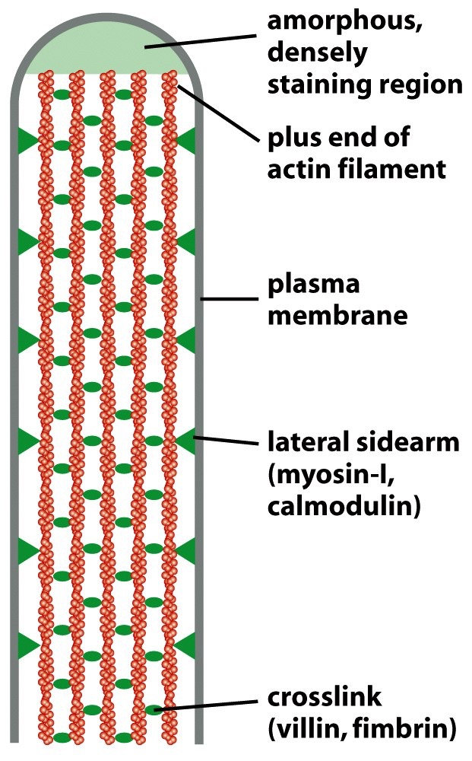
Actin: Bundles of Filaments in Cells
Microvilli
Notes:
Microvilli are the best-studied case of a tight parallel bundle, with attachments to the plasma membrane. Interesting questions are what is happening at the barbed ends - are they growing or not? And why is there a myosin present where it is - what does that do?

Slide 47
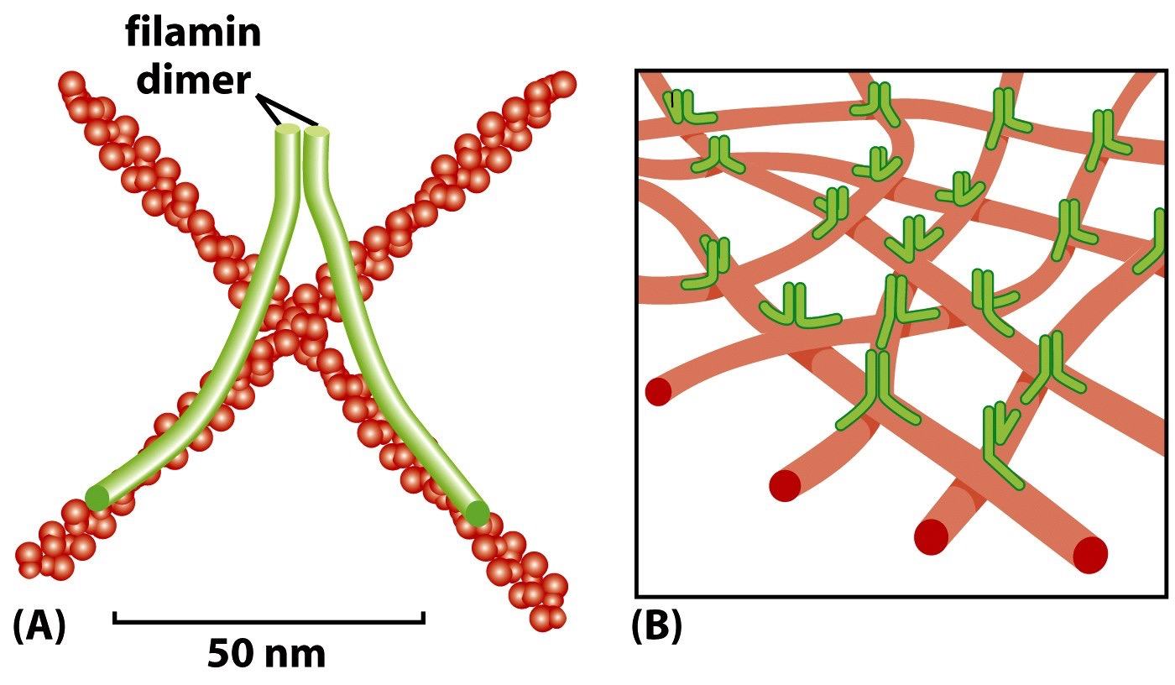
Actin: Gel-like Network of Filaments in Cells
Lamellipodia
Notes:
Lamellipodia are found at the leading edge of migrating cells. At the very front, Arp2/3 complex creates a branching (dendritic) network, and then proteins such as filament create “spot welds” between overlapping filaments. Presumably, the point is to make the cytoplasm be strong and dense, providing a solid footing for protrusions at the front.

Slide 48
III. Motor Proteins
Actin - Myosins
Microtubules - Kinesins and Dynein
Notes:
Actin filaments and Microtubules both serve as tracks or roads on which motor proteins travel. All actin motors are of one type, called “myosins,” and Microtubule motors come in two very different types - kinesins and dyneins.

Slide 49
Motor Proteins
Transport
Different type of cargoes
Golgi stacks
Vesicles
Mitochondria
Actin or Microtubules
Bundle sliding
Muscle contraction
Ciliary movement
Motor proteins
ATP
ADP+Pi
Actin or Microtubules
Plus or minus end-directed
Notes:
Illustration of two major ways that motors work - they cause filaments in bundles to slide past one another, and they carry cargo.

Slide 50
Notes:
Myosins have a motor domain called the head, which is attached to a lever arm called the neck. The head binds to actin and to ATP. It hydrolyzes ATP and converts that chemical energy into the mechanical energy (work) of movement. The head is part of one polypeptide called the heavy chain, which can be very long, extending well beyond the lever arm. To make the lever arm strong, the heavy chain polypeptide in this region is bound by two other polypeptides called light chains. The “essential” light chain is completely necessary for the lever arm to work. The “regulatory” light chain controls the lever arm, essentially switching the motor on and off at times.

Slide 51
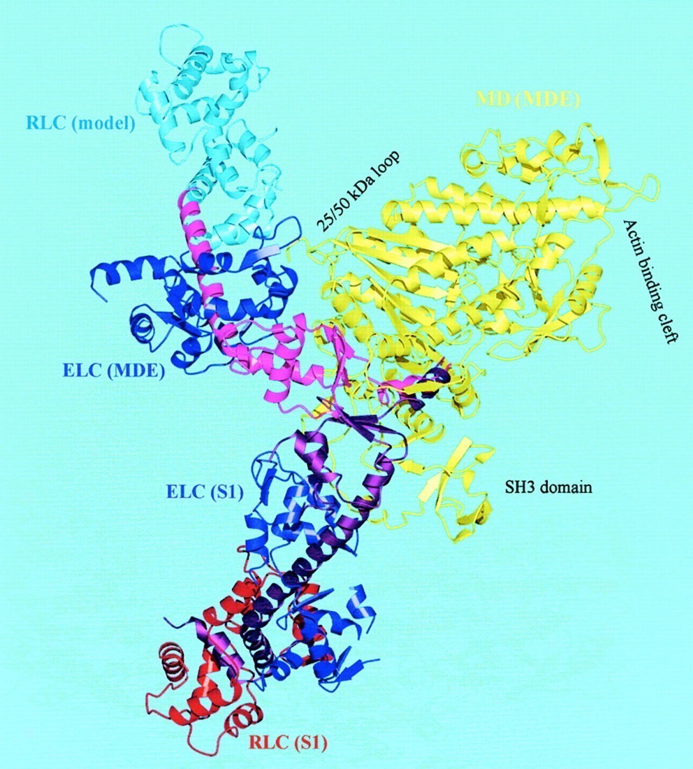
Twisting Head Model
Myosin Lever Arm Orientations
Notes:
This picture of two high-resolution (X-ray crystal) structures of myosin illustrates how much the lever arm can swing. The heads were lined up with each other and colored yellow. The lever arms of the two different structures are in very different places.

Slide 52
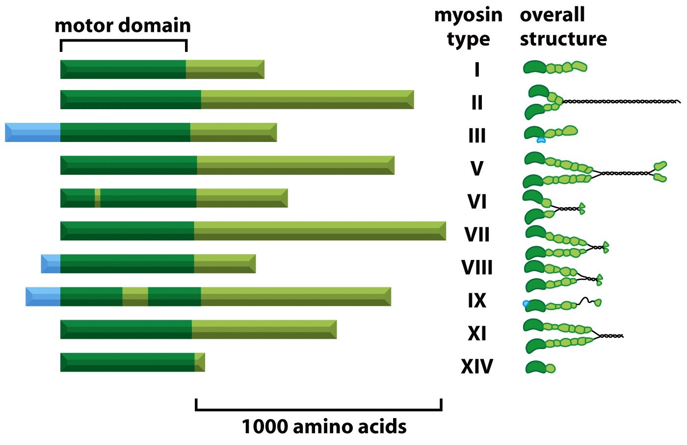
Actin-based motors: Myosin superfamily
Humans have ~40 myosin genes
Walk to Barbed (+) end of Actin Filament (except Myosin VI)
Cellular organization
Contractility
Transport
Only the motor domain is conserved
ATPase and Actin binding Sites: Linked Functions
Notes:
Myosins come in many types. They are defined as myosins by their motor (head) domain. Aside from that, the tails are completely different from each other. This drawing is a bit misleading in that respect, because the tails are all drawn in the same light-green bar structure. I would have drawn them each with completely different colors. You can being to appreciate this from the drawings on the right, but even they give the misleading impression that some of the pieces and parts might be the same. They are not. Even the coils that wind around each other - they only wind around another copy of the exact same polypeptide, not any other one.

Slide 53
Myosin-II Dimer Moving on Actin Filament
Notes:
Animation showing how myosins interact with actin, bind and hydrolyze ATP, and produce motion. This is one type of myosin, called class-II, which is the one found in sarcomeres of striated muscle. Other myosins work in the same way, but the details especially the timing (kinetics) of the steps can vary a lot, depending on what the myosin does for the cell.

Slide 54
Myosin Motor: Motion from Chemical Energy
Binding of ATP -> decreased affinity for actin (myosin head detaches)
Weak binding of myosin to another (next) actin -> release of Pi -> tight binding
Closing of ATP-binding cleft -> large conformational change (5 nm displacement)
ADP released during power stroke
Notes:
Illustration in diagrams and words of what we saw in the movie on the last slide. The important point is that the machine works because it doesn’t skip steps or slip backwards. That would be like cylinders in a car engine firing without force being applied to the wheels (like when you are in neutral).

Slide 55
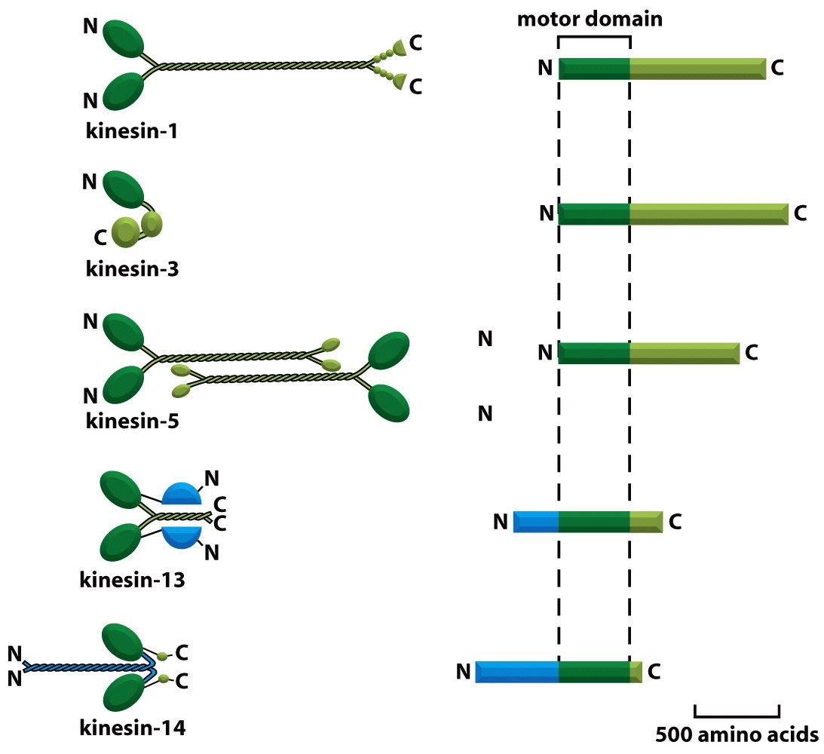
Microtubule-based motors: Kinesin superfamily
Humans: 40 kinesin genes. Generally Plus (+) end directed.
Homodimer
Monomer
Move membrane organelles
Tetramer (antiparallel)
Push apart mitotic spindle
Catastrophin
Loss of motor activity
C-term motor
Moves to (-) end
Notes:
Kinesins also come in many different types. They have common head (motor) domains, which define them as kinesins. Their tails differ widely and are designed for very different functions. Almost all kinesins try to walk toward the plus end, except for one (at the bottom), which goes backwards. How does your car transmission switch directions?

Slide 56
Kinesin-1 Dimer Moving on Microtubule
Notes:
Animation of kinesin walking. Many of the steps are similar to those for the myosin motor. One difference here is that the two heads are working together very closely. The one that is attached holds tight until the next one is attached. What is that good for?

Slide 57
Kinesin Motor: Motion from Chemical Energy
ATP binding to front head causes rear head to be thrown forward
Release of ADP and hydrolysis of ATP brings back the dimer to original state
Kinesins
0.02 to 2μm/sec
Tightly bound with ATP
Very processive
Notes:
Kinesin, like myosin, converts chemical energy from ATP into mechanical energy of movement. The term “processive” refers to the fact that the two heads work together to remain attached, so together they take many steps and move long distances before they are detached.

Slide 58
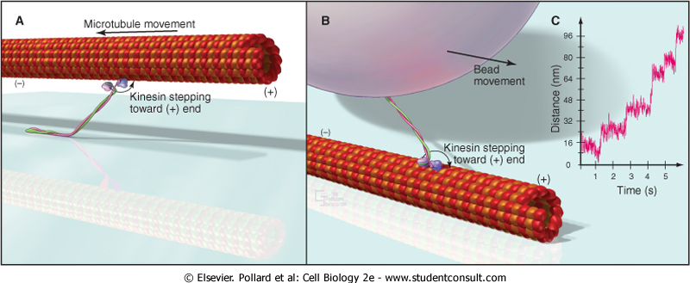
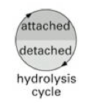
Microtubule-based Motors
Kinesin-1
Avoids loss of cargo
Notes:
Illustration of how processive action of kinesin motors is good for moving cargo. One molecule might be enough to move the cargo a long distance, if it has enough power.

Slide 59
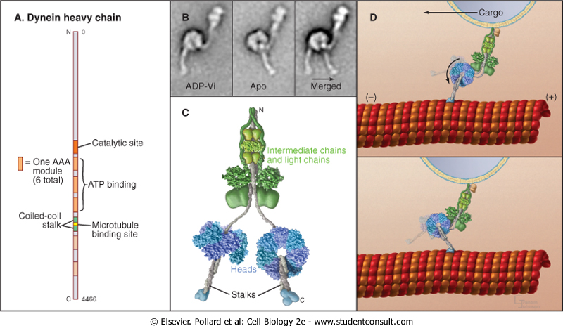
Microtubule-based Motors: Dyneins
Different evolutionary origin from Myosins and Kinesins
AAA proteins (ATPases Associated with diverse Activities)
Cytoplasmic dynein - vesicle transport and position
Motor component of cilia and flagella
Notes:
Dyneins are completely different molecules from kinesins. They are much larger and have many associated chains - heavy, intermediate, light intermediate and light chains. They move in the opposite direction (usually) - toward the minus end.

Slide 60
IV. Cellular Machines Based on Microtubules and Actin
Skeletal muscle (Actin with myosin-II)
Cilia, flagella (Microtubules with dynein)
Mitotic spindle (Microtubules with kinesin & dynein)
Notes:
Cells construct nano-machines that perform essential biological functions using actin and microtubules.

Slide 61
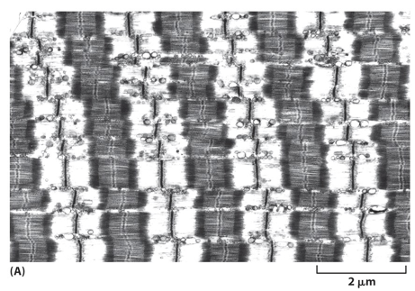
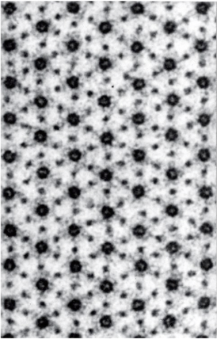
Striated (Skeletal & Cardiac) Muscle
Filaments, Sarcomeres, Myofibrils
Cross-Section
Myosin-II (Thick)
Actin Filament (Thin)
Notes:
Dr. Bridgman lectured about striated muscle, the myofibril and the sarcomere in Histology, and he discussed how they function in muscle contraction in Physiology.
The molecules are our focus here - the “sliding filament” model.

Slide 62
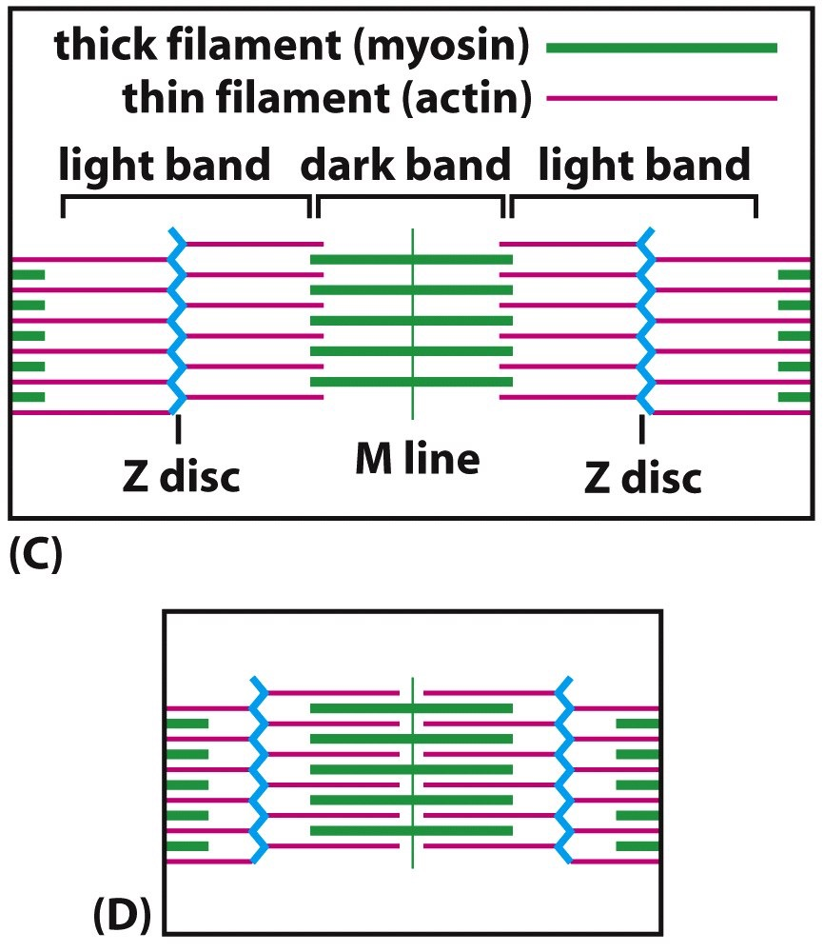
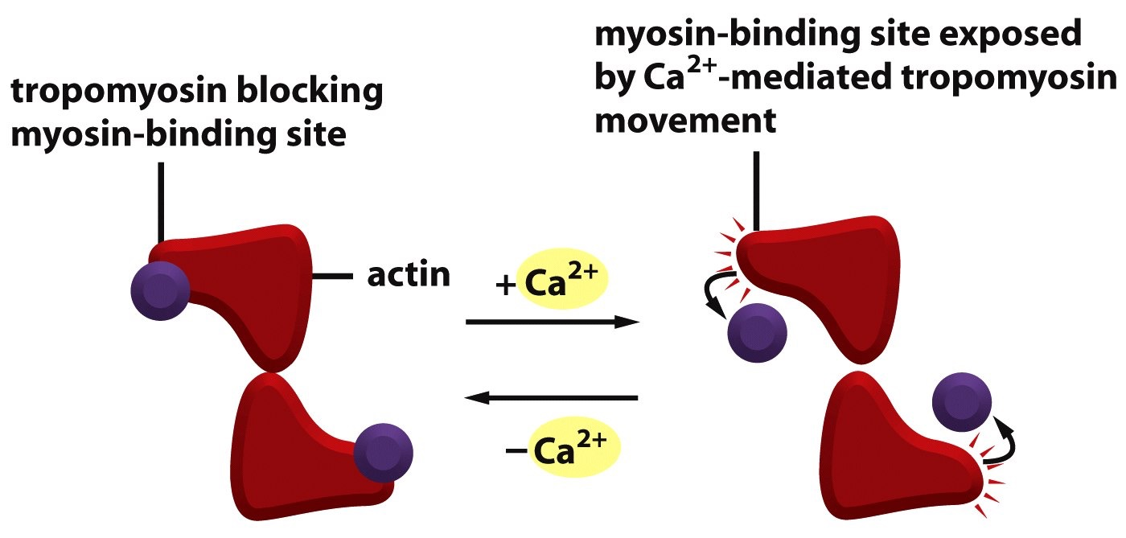
Ca2+-Based Regulation of Contraction
-
+
Notes:
Muscle contraction is triggered by rapid increase in Ca2+ in cytoplasm, secondary to action potential from the neuromuscular junction. Ca2+ binds Troponin C, which is in a complex with Troponin I and Troponin T. Together, they regulate tropomyosin. At rest, tropomyosin blocks the sites on the actin filaments to which myosin wants to bind. Ca2+ causes tropomyosin to roll out of the way, not leave entirely. The process is cooperative along the length of the actin filament, so that the process is “all or none.”

Slide 63
Familial Hypertrophic Cardiomyopathy
Inherited human disease
Heart dysfunction - sudden death
Autosomal dominant
Myosin heavy chain gene first
Other sarcomere components
Subtle mutations
Mild effects on biochemical function
Notes:
Familial hypertrophic cardiomyopathy is an autosomal dominant disorder, that is generally undetected until sudden death. Tragic cases of young people, including athletes and pregnant women, whose hearts are under stress. Subtle biochemical effects due to single amino acid change. The heart accommodates well, but the histology becomes altered over time, and conduction pathways become affected. Suddenly, under stress, conductions proceeds via an altered pathway, leading to “fibrillation” in which the heart muscle contracts in a wildly disordered pattern and pumps little to no blood.

Slide 64
Cilia and Flagella
Flagella
-helical motion
-sperm and many protozoa
Cilia
-whip-like motion (swimming breast stroke)
-move cells in fluids or fluids over cells
Notes:
Flagella and Cilia are motile structures driven by a common Microtubule-based nano-machine, the axoneme. Flagella are generally single and show helical wave motion. Cilia are generally multiple and beat together in a wave-like motion.

Slide 65
Axoneme: Motor Core of Cilia and Flagella
“9+2”
Notes:
Axoneme is the name of the underlying machine, built from Microtubules and about 250 other proteins. Nine pairs of “doublet” Microtubules (A and B) around the outside. One pair of two “singlet” Microtubules in center. Hence, “9 + 2.” Dynein motors attach to A tubule. They reach out, bind and attempt to slide on B. All the components are linked together, so sliding occurs but in a very limited way, propagated down the length of the structure, from base to tip.

Slide 66
How Motion is Generated
Dynein Arms Connect the Microtubule Pairs
Microtubule Pairs Anchored at Base
10
13
Notes:
How motion is generated. Left: A) 2-d protein gel showing the many components. B) EM cross-section. C and D) Diagrams showing the dynein arms and the radial spokes. Right: Microtubules are anchored in at the base of the axoneme in a structure, the “basal body.” Ensures that no Microtubules slide past each other here, so sliding occurs along the length, bending the structure.

Slide 67
How Motion is Generated
Notes:
Bending of axoneme occurs because dynein attempts to slide, cannot go very far, resulting in bend.

Slide 68
Mitotic Spindle: Movement of Chromosomes
Notes:
Microtubules assemble into mitotic spindle, which separates chromosomes. Microtubules are very dynamic, nucleated from centrosomes (after duplication and separation). Minus ends at poles, with plus ends reaching out and binding to chromosomes. Kinesin motors helps move the chromosomes to the center of the cell, first. Other types of kinesin help push the poles apart. Dynein anchored at the cell periphery pulls on Microtubules, which also helps move the poles apart and ensures that each daughter cell gets one set of chromosomes. Later, when sister chromatids separate, and one of each pair moves to the pole, what motor positioned where might do this?

Slide 69
Intermediate Filaments
Filaments 10 nm wide => “intermediate”
Present in Metazoa / Animals
i.e. not Plants or Unicellular Organisms
Complex Gene Superfamily
70 in Human Genome
Specific Expression at Different Times and Places
Notes:
Intermediate filaments are named because, in striated muscle, their width is “intermediate” between that of actin filaments, which are “thin,” and myosin filaments, which “thick.” Many human genes, expressed in different cell types are different times.

Slide 70
Biochemical Properties In Vitro
Very stable. Little subunit exchange.
Very strong. Filaments do not break.
MT’s strong but brittle
Actin weak
Notes:
Biochemical properties of IFs are very different from those of actin and Microtubules. They are very strong and very stable. Impart mechanical strength and stability to the cytoplasm.

Slide 71
Potential Functions In Vivo
Mechanical Strength of Cytoplasm
Help a Layer of Epithelial Cells Resist Shear Stress - Filaments Connect to Cell-cell Junctions
Hold Nucleus in Center of Cell
Notes:
IFs biochemical properties allow them to help the cells remain intact (resist shear and other physical forces). Also to keep the nucleus in the center of the cell, which is especially good if a cell is migrating.

Slide 72
Structure & Assembly
Notes:
IF structure and assembly has one very critical difference from actin and Microtubules - NO polarity. At an early stage, two dimers bind to each in an anti-parallel fashion, creating a tetramer that is symmetric. Everything built from that tetramer can NOT have polarity. Are there motors that work on IFs? Are the two ends of the IF different?

Slide 73
Filament Unraveling: EM
Notes:
IFs can be made to unravel. No evidence of helical symmetry - another difference from actin and Microtubules.

Slide 74
Classes of IF Proteins
Notes:
IF proteins can be classified into five major groups. Classes I and II are keratins, acidic and basic, respectively. One acidic binds to one basic, making heteropolymers. Class III IFs are homopolymers, in the sense that one type of protein subunit can assemble with itself to make the filament. Class IV include neurofilaments, which have three different polypeptides - heavy, medium and light - making up one filaments. Class V are called lamins; they can form IFs as homopolymers or heteropolymers.
None of the class cross-polymerize. One cell can have keratin filaments, vimentin filaments and lamin filaments - they are separate from one another.

Slide 75
Regulation of IF Assembly
Notoriously Stable
No Nucleotide
Filaments Move Little
Precursors Move More
Disassemble Somewhat during Mitosis
Phosphorylation by Cyclin-dependent Kinase (CDK)
Notes:
IF assembly. IFs are extremely stable, making them very difficult to study for biochemists. Do not bind nucleotide, unlike actin and Microtubules. The whole filament moves very little, but the precursors do move a bit, in order for an IF to grow. During mitosis, they have to clear out, in order for the mitotic spindle to have space to do its work. Disassembly during mitosis is induced by the major kinases that control the cell cycle.

Slide 76
Vimentin
All Cells in Early Development
Cage Around Nucleus
Interacts with Microtubules
Vimentin Knockout Mouse
Initially normal at gross inspection
Cultured cells have altered properties of uncertain significance
Notes:
Vimentin forms a cage around the nucleus. Present in almost cells early in development, then the cells often switch to another kind of IF. Microtubules interact and track long them. Surprisingly, a mouse lacking vimentin is grossly normal - this baffles the experts.

Slide 77
Vimentin: Cage around Nucleus
Vimentin Filaments in a Cultured Cell
Notes:
Fluorescence micrograph showing vimentin filaments making cage around nucleus, extending out to the cell edge. Nucleus is held in place.

Slide 78
IFs are Dynamic but Relatively Stable: FRAP of Vimentin vs. Keratin in One Cell
Left: Vimentin (Green)
Right: Keratin (Red)
10-min time intervals
Notes:
IFs are stable and separate from each other. Photobleaching experiment illustrates the timing of the turnover of the filaments. Requires 20 minutes (or more). Actin and Microtubules turn over in seconds.

Slide 79
Dynamics of IF Particles in Cell Periphery
11 micrometers
over 10 minutes
18 micrometers
over 10 minutes
Notes:
At the edge of the cell, the IFs are thin and much more dynamic than what appears to be the case when one looks only at the central cytoplasm.

Slide 80
Desmin
Expressed in Muscle
Elastic Elements to Prevent Over-stretching
Connects / Aligns Z lines
Knockout Mouse - Deranged Myofibril Architecture
Notes:
Desmin IFs form in striated muscle. They form elastic elements (rubber bands) that keep the sarcomeres from over-stretching and they keep the myofibrils aligned with each other.

Slide 81
Keratins
Expressed in Epithelia
Keratin Filaments Connect to Desmosome and Hemidesmosomes
Differentiation of Epidermis includes Production of Massive Amounts of Keratin
Provides Outer Protection of Skin
Composes Hair, Nails, Feathers, etc.
Notes:
Keratins are expressed in epithelial cells - what are some examples of those?
Forms the outer layer of skin. As epidermal cells progress from bottom to top of epidermis, they became simple masses of keratin filaments.
Special skin cells make hair, nails, feathers and tortoise shells.

Slide 82
Density of Keratin Filaments in Outer Epidermis Layers
Notes:
EM illustrating high density of keratin filaments at top layers of epidermis.

Slide 83
Keratin Mutations are Basis for Human Epidermal Diseases
Structure/Function Analysis of Keratin Assembly
Point Mutation in Terminal Domain Fails to Assemble
Mutant is Dominant, even in Low Amounts, in Cultured Cells and Mice
Notes:
Mutations in keratin genes cause a family of human skin diseases. Discovered by a basic science researcher interested in how the genes and proteins work. Made mutations in order to figure out which parts of keratin proteins were important for assembly. Realized that expressing these mutant keratins in cells had dominant effects, even in very low amounts - all the keratin filaments failed to assemble. How could this happen?

Slide 84
Epidermolysis Bullosa Simplex
Wild-type
Mutant
Notes:
The scientist also expressed the keratin mutations in mice. Realized that the mice had blisters on their skin, similar to some humans who are born with blisters and suffer from them throughout their life. “Bullosa” means blister. She sequenced the keratin genes of the human patients - they had the same amino-acid changes that she had engineered originally, attempting to understand how keratins assemble into filaments.

Slide 85
Keratins and EBS
Notes:
Keratin mutations lead to loss of keratin filaments, which leads to fragile skin. Different keratin genes expressed in different layers of the epidermis - that determines the location and severity of the blister.

Slide 86
Gene Therapy for Epidermolysis Bullosa
“Gene Therapy Creates Replacement Skin to Save a Dying Boy.” NY Times, 2017 Nov 8.
Anchors for epidermis to dermis. Recessive mutations: Add wild-type protein.
Laminins.
“Regeneration of the entire human epidermis using transgenic stem cells.” www.nature.com/articles/nature24487
Collagen Type VII.
“Safety and Wound Outcomes Following Genetically Corrected Autologous Epidermal Grafts in Patients With Recessive Dystrophic Epidermolysis Bullosa.” JAMA. 2016. 316:1808.

Slide 87
Neurons
Neurofilament H, M, L Copolymer
Prevent Axon Breakage
Diseases with Clumps of Neurofilaments
Superoxide dismutase model for ALS
Clumps are secondary, not causative
Notes:
Neurofilaments are composed of three different polypeptides - heavy, medium, light. They fill the axons and dendrites to help prevent them from breaking. Why is this so important? If they break, they don’t grow back!
Example of confusion about cause and effect in disease research. Clumps of neurofilaments are seen in many diseases where neurons die, including amyotrophic lateral sclerosis (ALS aka Lou Gehrig’s disease). Researchers hypothesized that the disease was caused by these clumps, which were resulting from abnormal neurofilament assembly. However, other people found that mutations of an enzyme, superoxide dismutase, can cause ALS, including in mice. Using mice, they knocked out the neurofilament genes, so the mice had no neurofilaments. They still got ALS. Clumps are an effect, not the cause, of the disease.

Slide 88
Neurofilament Transport in Axons
Photobleached Zone in the Middle
Notes:
Neurofilaments are very stable. How do they form? Clever photobleaching experiment reveals that small packets of neurofilament protein are zipping around, up and down the axon. Without the photobleaching, the little packets are obscured by the big clumps of filaments.

Slide 89
Lamins
Square Lattice on Inner Surface of Nuclear Membrane
Present in Metazoans (Animals, not Plants or unicellular organisms)
Mitosis Breakdown
Phosphorylation of A & C by Cyclin-dependent Kinase
B remains with Membrane
Mutations Cause Accelerated Aging Diseases
Progerias - Dominant Mutations
Notes:
Lamins form square-lattice meshworks on the inner surface of the inner nuclear membrane. Recall there are inner and outer. Important to give the nucleus shape and strength. Need to break down during mitosis.
Geneticists and molecular biologists found that humans with accelerated aging, “progeria”, have mutations of lamins. How and why this causes accelerated aging is mysterious.

Slide 90
Nuclear Lamina
Square Latticework by EM
Nuclear Pores
Notes:
EMs show beautiful square latticework of lamin filaments. Nuclear pores are seen enmeshed in the latticework.

