Slide 1
Cell-Cell and Cell-Matrix Interactions:
Focus on Integrins
John Cooper
Dept of Biochemistry & Molecular Biophysics
www.cooperlab.wustl.edu
jacooper@wustl.edu
November 19, 2019
Notes:
Integrins are major topic of this lecture, in the context of how cells interact with each other and the extracellular matrix (ECM).

Slide 2
Goals of lecture
Context: Cell adhesion and ECM molecules
Integrins: molecular structure & function
Activation of integrins: mechanism and roles in physiology
Examples of human disease based on integrin dysfunction
Notes:
Outline and goals for this lecture. Place integrins in context of other lectures. Dr. Bridgman’s lectures on epithelial cell biology, including cell-cell junctions and basement membranes. Fundamentals of what integrins are and what they do. How they become activated, and how they signal inside the cell. Selected examples illustrating how integrins are important for human physiology and disease.

Slide 3
Reading in Textbooks
Alberts et al., Molecular Biology of the Cell, 6th ed., 2014, Garland.
  Chap. 19 - Cell Junctions and the ECM.
  Available as eBook, https://bit.ly/2AR19DR.
Lodish et al., Molecular Cell Biology, 8th ed., 2016, Macmillan.
  Chap. 20 - Integrating Cells into Tissues.
  Available as eBook and hard copy, https://bit.ly/2Qy9Hog.
Pollard et al., Cell Biology, 3rd ed., 2016, Elsevier.
  Section VIII: Cellular Adhesion and the ECM. Chaps. 28-32.
  Available as eBook and hard copy, https://amzn.to/2OwoAWC.
Notes:
Textbook chapters that relate to the material today. Perhaps you own or can borrow one of these books. Provides background for those for whom the material is very new, and provides extra information for those who are experts and interested.

Slide 4
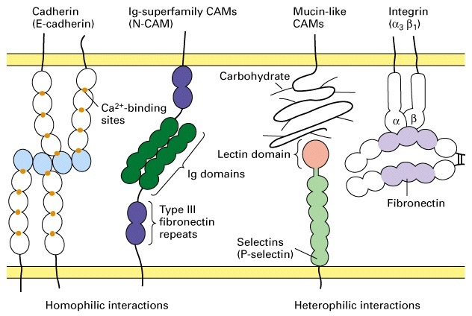
Four principal classes of cell-adhesion molecules (CAMs)
Copyright (c) by W. H. Freeman and Company
Notes:
Drawing to illustrate the major types of cell adhesion molecules, “CAMs.” Integral membrane proteins with extracellular domains that interact with proteins on other cells or in the interstitial space, i.e. extracellular matrix (ECM).
Cadherins and Ig-CAMs, on left, are homophilic - interact only with other molecules like them. Cadherins require Ca2+.
Mucin-like CAMs interact with selectins. Carbohydrates attached to the proteins are important.
Integrins are alpha / beta heterodimers that interact with fibronectin and other molecules.

Slide 5
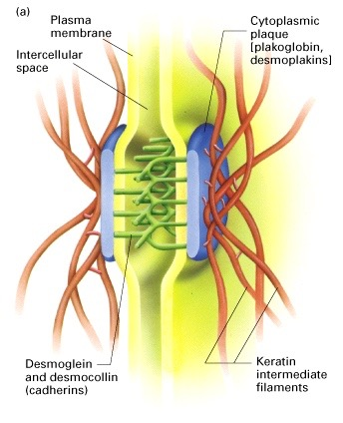
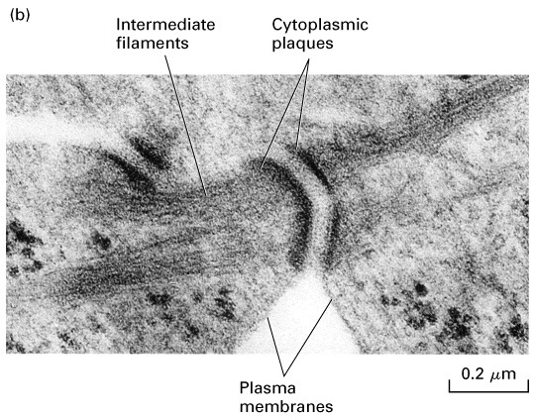
Desmosomes provide strength and rigidity to epithelial layer
Copyright (c) by W. H. Freeman and Company
Notes:
Desmosomes: cell-cell junctions discussed in Histology in lectures and labs on epithelial cells, notably epidermis of skin. Act as spot welds between cells, connecting the keratin intermediate filaments of each cells, creating one large network among all the cells in a sheet.
Junctions include cadherins, with special names.

Slide 6
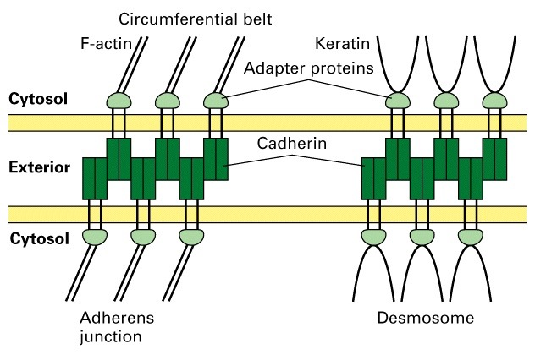
Cadherin junctions connect cells: Adherens Junctions and Desmosomes
Copyright (c) by W. H. Freeman and Company
Notes:
Adherens junctions involve cadherins, like desmosomes, but shaped like belts or rings, not spots. Connect to actin filaments, not keratin filaments, in cytoplasm.

Slide 7
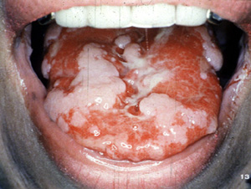
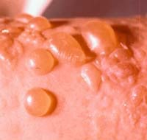
Pemphigus Vulgaris: Disease of Desmosomes
Auto antibodies to desmoglein 1 and 3 (type of cadherin)
Disrupt adhesion between epithelial cells
Involvement of skin and mucous membranes
Copyright (c) by W. H. Freeman and Company
Notes:
Diseases with dysfunctional desmosomes include blisters. Cells fail to hold onto their neighbors, the epithelial layer ruptures, and fluid fills the space.

Slide 8
Basement Membranes
Specialized layers of extracellular matrix surrounding or adjacent to all epithelia, endothelia, peripheral nerves, muscle cells, and fat cells
Originally defined by electron microscopy as ribbon-like extracellular structures beneath epithelial cells
Notes:
Basements membranes are dense special sheets of ECM that sit on the basal side of epithelial layers and other cells. They often define the boundaries between the layers. They can be crossed in a controlled manner during normal physiology, and they can break down as part of pathology.

Slide 9
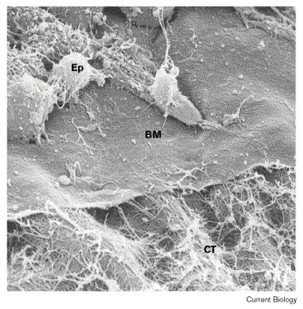
Basement Membrane
Epithelial
Cells
Basement
Membrane
Connective
Tissue
Schwarzbauer, J. 1999. Basement membranes: Putting up the barriers. Curr Biol. 9:R242-4.
Notes:
EM of a tissue that was ripped open in a particularly illuminating manner, revealing epithelial cells (Ep), the basement membrane (BM), and the connective tissue (CT).

Slide 10
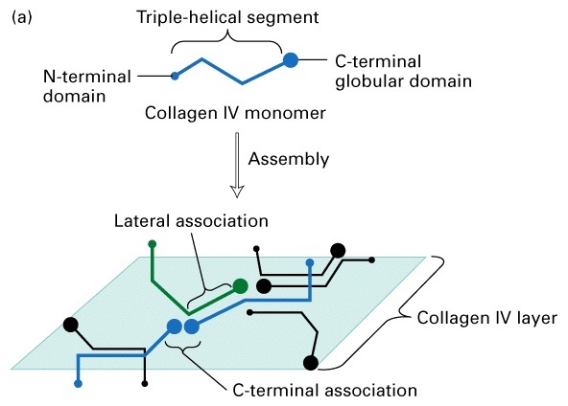
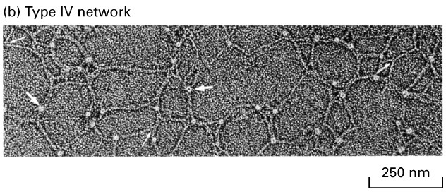
Basement membrane
Sheet based on type IV collagen
Copyright (c) by W. H. Freeman and Company
Notes:
Basement membrane. Major molecular components is one type of collagen, type IV. Where do you find types I and II? (30 types of collagen).

Slide 11
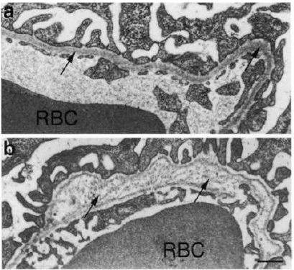
Type IV Collagen Mutations and Human Disease
COL4A1 mutations
  Small vessel disease / retinal vascular tortuosity
  Hemorrhagic stroke
  Porencephaly (brain cysts)
  HANAC syndrome
COL4A3/A4/A5 mutations
  Alport syndrome / hereditary glomerulonephritis
Kidney Glomerular BM
RBC
RBC
Miner JH, J Cell Biol 1996.135:1403-13
Notes:
Type IV collagen is encoded by multiple genes; the names start with “COL4.”
Mutations affect multiple organs, depending on where the gene is expressed.
HANAC: Hematuria, cystic kidney disease, intracranial aneurysms, muscle cramps.

Slide 12
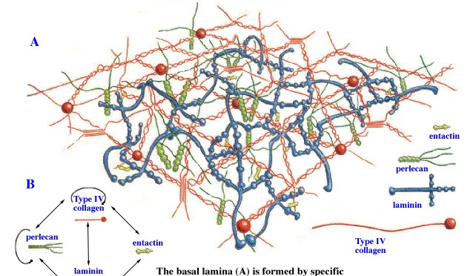
Components of Basement Membrane
Fredrik Skarstedt and Carrie Phillips
Notes:
Basement membranes are a meshwork composed of collagen-IV and a limited number of ECM proteins.

Slide 13
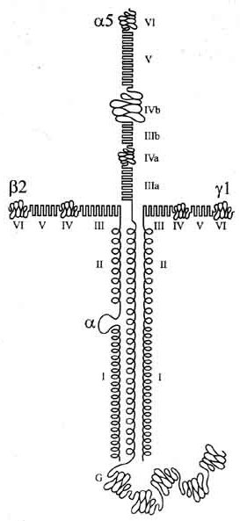
Laminin
Heterotrimers: Alpha, Beta and Gamma Subunits
400 to 800 kDa cruciform, Y, or rod-shaped macromolecules.
Major glycoprotein of basement membranes - Necessary.
Chains are evolutionarily related.
5 alpha, 4 beta, and 3 gamma chains are known. They assemble with each other non-randomly.
15 heterotrimers described to date.
Notes:
Laminin is one major basement membrane component. Forms from three different polypeptides - alpha, beta, gamma. Large, with extended shape.

Slide 14
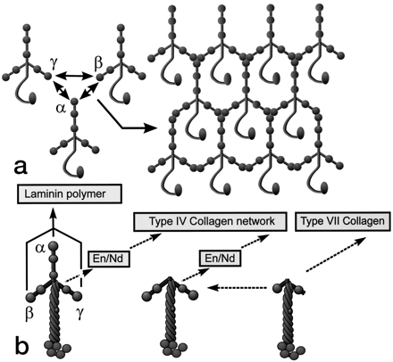
Laminin Trimers Polymerize
Laminin chains assemble into trimers in the ER and are secreted as trimers into the extracellular space.
Full-sized laminin trimers can self-polymerize into a macromolecular network through short arm-short arm interactions.
The α subunit LG domain is left free for interactions with cellular receptors.
Notes:
Laminins self-polymerize. Makes them uniquely suited to initiate basement membrane formation. The N-terminal “LN” domain is crucial for polymer formation; need alpha, beta and gamma to come together. The laminin polymer interacts with other proteins, namely cell surface molecules via the free LG domain of the alpha subunit.

Slide 15
Laminin Mutations in Mice (M) and Humans (H) Have Serious Consequences
Lama1, Lamb1, Lamc1: Peri-implantation lethality (M)
Lama2: Congenital muscular dystrophy (M, H)
Lama3, Lamb3, Lamc2: Junctional epidermolysis bullosa (skin blistering) (M, H)
Lama4: Mild bleeding disorder, motor / nerve terminal defects (M); cardiac and endothelial defects (H)
Lama5: Neural tube closure, placenta, digit septation, lung, kidney, tooth, salivary gland defects (M)
Lamb2: Neuromuscular junction and kidney filtration defects (M); Iris muscle, neuromuscular, kidney filtration defects (H; Pierson syndrome)
Lamc3: Brain malformations, autism spectrum disorder? (H)
Notes:
Diversity of laminin functions (15 types) revealed by wide range of phenotypes and diseases resulting from laminin chain mutations in mice and humans.
LAMA - gene for alpha chain. LAMB - beta. LAMC - gamma.

Slide 16
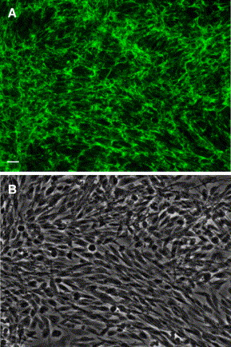
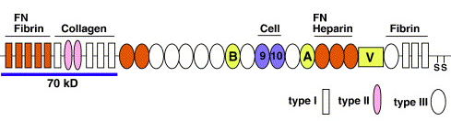
Fibronectin (FN)
Glycoprotein associated with many ECMs and present in blood (plasma)
Composed of multiple domains of different types
Alternative splicing generates many isoforms; they heterodimerize via S-S covalent bonds
Fibroblasts synthesize FN, secrete it, adhere to it, and respond to its presence
Harbors “RGD” motif - ligand for various integrins, especially α5β1
Knockout mice die as embryos with defects in vasculature and heart development
RGD
Mao, Y. & J. E. Schwarzbauer. 2005. Fibronectin fibrillogenesis, a cell-mediated matrix assembly process. Matrix Biol. 24:389-399.
Notes:
Fibronectin is a major protein of the ECM. Composed of multiple domains that come in three major types - I, II and III. Includes a motif “RGD” that binds to integrins on the surface of cells. RGD is in III-10; cells grown with serum are exposed to plasma fibronectin

Slide 17
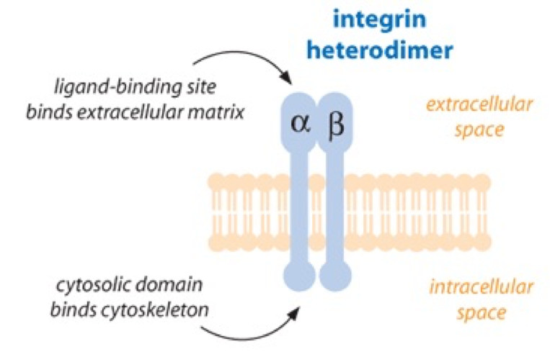
Integrins
Large family of transmembrane receptors for ECM and cell-surface proteins.
Heterodimers of alpha and beta subunits
Both subunits contain single-pass transmembrane domains.
16 different α chains and 8 different β chains => 22 distinct heterodimers.
Cytoplasmic tails of both subunits create cell signals, in response to ligand binding.
Notes:
Integrins are alpha / beta heterodimers. Both subunits are transmembrane proteins.
The cytoplasmic tails are short; they associate with other proteins in order to produce signals.

Slide 18
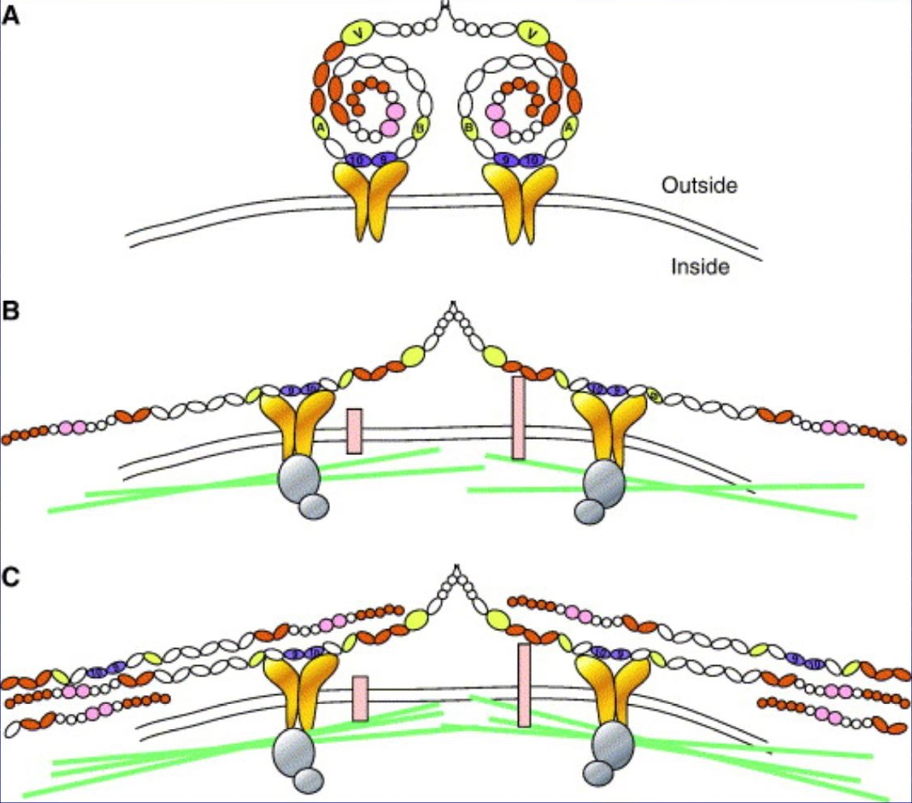
Integrins Direct FN Fibril Formation
Compact soluble FN binds integrin
FN binding induces reorganization of actin and signaling
Cell contractility leads to changes in FN conformation, exposing FN interaction domains and allowing fibril formation
Mao, Y. & J. E. Schwarzbauer. 2005. Fibronectin fibrillogenesis, a cell-mediated matrix assembly process. Matrix Biol. 24:389-399.
Notes:
Fibronectins assemble outside the cell, interact with integrins, and integrins interact with actin. Positive feedback from actin to fibronectin assembly - they each promote the other.
Actin-based cell contraction pulls on FN, promoting conformational changes that expose hidden binding domains. Fibrils of FN form through interactions between FN molecules.

Slide 19
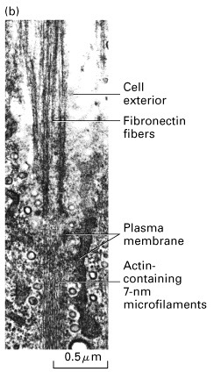
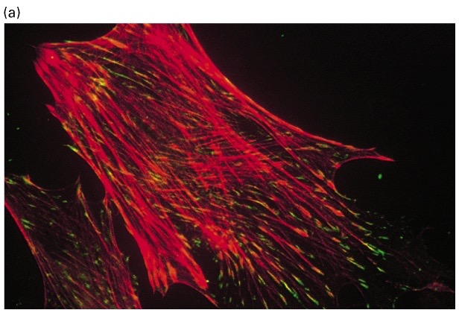
Integrins were Discovered at “Focal Adhesions”
What is the connection across the cell’s membrane that links the sites of ECM contact to the cytoskeleton?
Researchers found monoclonal Abs that blocked attachment and cytoskeletal organization. These Abs found to bind to transmembrane receptor proteins - now called integrins.
Notes:
Integrins were discovered by researchers investigating how cultured cells interact with ECM and their substrate. Created monoclonal Abs, screened them for ability to block attachment of cells to substrate and the organization of actin into stress fibers. The ones that worked were found to bind to transmembrane proteins we now call integrins. These sites of attachment, in cultured cells, are called “focal adhesions.” These not the same as desmosomes, which are also spots (foci) of adhesion.

Slide 20
Integrins bind to Ligands
Some integrins bind to a specific site on ECM proteins, composed of amino-acid residues Arg-Gly-Asp (RGD).
These ECM proteins include fibronectin, vitronectin, and tenascin.
They function as ligands for the integrin receptor.
Ligand binding requires divalent cation, e.g. Ca²⁺.
Notes:
Integrins are cell-surface receptors that bind to ECM proteins as ligands. Some of these ligand contain the triple amino-acid sequence RGD.
The ligand / receptor interaction requires a divalent cation. What divalent cations are present outside the cell? Inside the cell?

Slide 21
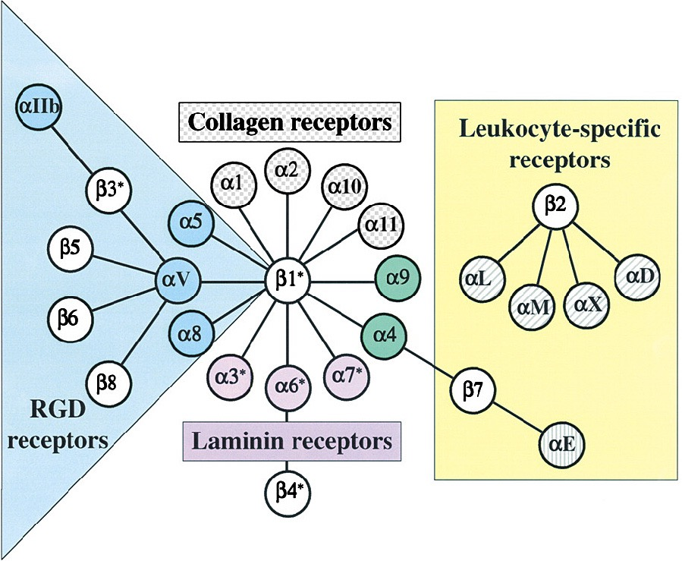
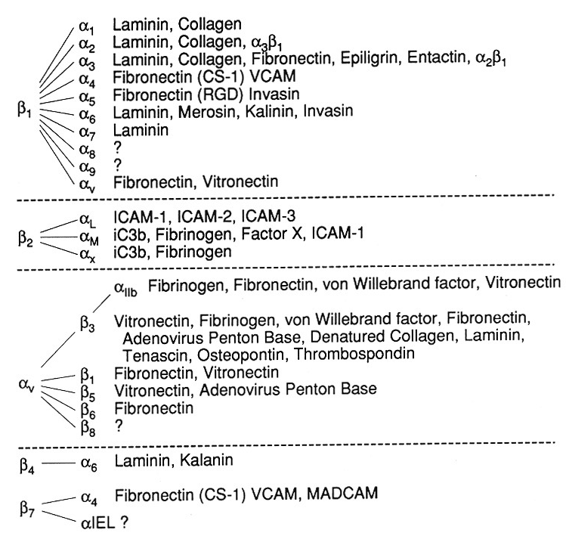
Integrin Family Members and Their Ligands
Hynes (2002) Cell 110:673
Notes:
Diagram showing how different alpha subunits interact with different beta subunits, on the left. Shows which integrin subunits bind RGD, collagen, laminin and which are specific to leukocytes.
On the right, list of extracellular proteins that bind to various integrins.

Slide 22
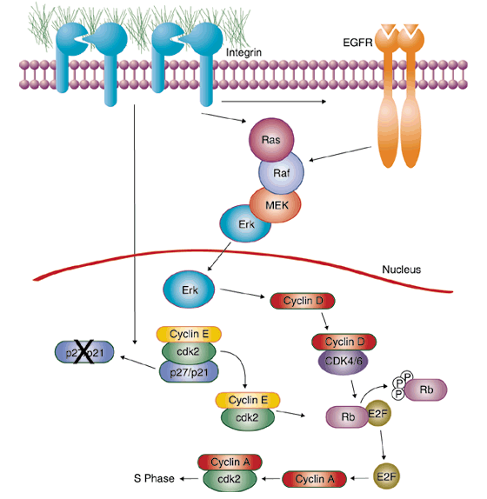
Integrin Signaling Pathways
Signal transduction proteins associated with, or activated by, integrins. Signaling molecules, such as FAK, bind to and recruit additional signaling molecules, creating a complex signaling network that is intimately connected to the cytoskeletal network.
Integrins and growth factor receptors cooperate in cell cycle regulation. Both growth factors and cell adhesion are required for transmitting signals to the Ras/Raf/Mek/Erk signaling pathway.
Miranti and Bruge (2002) Nature Cell Biol. 4:83
Notes:
Integrin signaling. Dr. Pike discussed Ras/Raf/Mek/Erk signaling in her receptor tyrosine kinase lecture. Appears to be complex, and simple linear pathways would be easier to understand. However, this level of complexity, with multiple pathways overlapping and feeding back on one another, in large multisubunit complexes, is likely to be the rule, not the exception. We need to embrace this level of complexity to make progress.

Slide 23
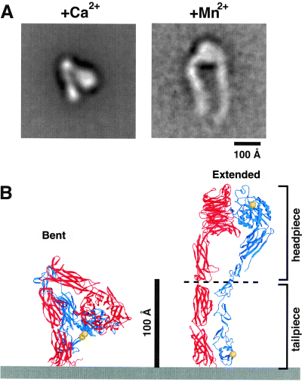
Activation of Integrin
Activation increases integrin affinity for ligand. Makes the binding site more accessible to ligands
A) EM images of the purified extracellular domain of an integrin. (Ca2+ inhibits ligand binding, Mn2+ stimulates artificially.)
B) Drawing of how images relates to integrin conformation.
Takagi et al. Immunol. Reviews; 2002, 186:141-163.
Notes:
Integrins exist in two major states - inactive and active. In the inactive states, the conformation of the extracellular part of the protein (both alpha and beta subunits), is bent and folded over, hiding the ligand binding site. In the active state, the extracellular portion is unfolded and extended, exposing the ligand binding site.
“Inside-out” refers to activation of integrin caused by signals from inside the cell.

Slide 24
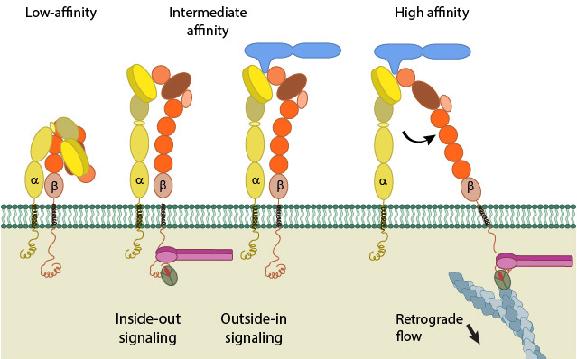
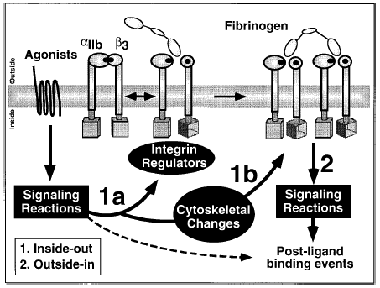
Integrins display “Inside-Out” and “Outside-In” Signaling
Inside-out signaling:
Initiated by G protein-coupled receptors that activate kinases leading to RAP1 activation.
Outside-in signaling:
Initiated by ligand binding and clustering of integrins leading to activation of Src kinase.
Fibronectin
Talin
Kindlin
Actin
Notes:
Integrins display signaling in both directions across the membrane: “inside-out” and “outside-in.” Important findings with significant influence on research on other membrane receptors.

Slide 25
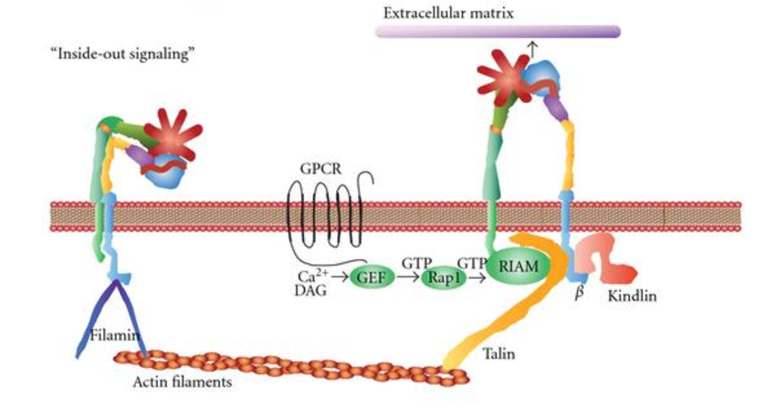
Signaling Pathways Leading to “Inside-Out” Activation
Integrin activation by extracellular agonists, ie, inside-out signaling involves G protein-coupled receptors (GPCRs), kinase cascades and activation of GDP > GTP exchange on Rap1, a small G protein.
Notes:
GPCRs and their signaling pathways interact with integrin signaling pathways. Dr. Pike discussed GPCRs, including how they activate phospholipase C to make Diacylglycerol (DAG) and inositol triphosphate (IP3), thereby activating Protein Kinase C (PKC).

Slide 26
Integrins in Human Physiology & Disease
hemostasis
osteolysis
angiogenesis
metastasis
hematopoiesis
immune surveillance
inflammation
Notes:
Integrins play important roles in a wide variety of cells. Their dysfunction can lead to disease. Altering the activity of integrins can be valuable treatment options for various diseases, including ones not primarily caused by abnormalities of integrins.

Slide 27
Integrins and Disease
Diseases treated w anti-integrin therapies:
Crohn’s Disease Psoriasis
Inflammatory bowel disease Multiple Sclerosis
Ulcerative colitis Asthma
Rheumatoid arthritis Osteoporosis
Ischemia-reperfusion injury Graft vs host disease
Thrombosis Atherosclerosis
Autoimmune diabetes Transplant rejection
Cancer and metastasis Tumor-dependent osteoporosis
Occlusive stroke leading to fracture
Stem cell mobilization (leukemias)
      Diseases with autoimmune or immunological component
Notes:
Many diseases are treated with therapies that inhibit integrins. Many of these diseases appear to involve excessive activity of the immune system.

Slide 28
Platelet Aggregation Depends on Integrins
ADP
ADP
Thrombin
Thrombin
Fibrinogen
Fibrinogen
GP IIb-IIIa
GP IIb-IIIa
GP Ib-V-IX
GP Ib-V-IX
Fibrinogen
vWf
Fibrinogen
vWf
GPIIb-IIIa
antagonist
GPIIb-IIIa
antagonist
Platelet aggregation
Example of “on-demand” activation of an integrin.
Tight suppression and rapid activation of the integrin are critically important.
Notes:
Several stimuli start the process by “activating” platelets – ADP, Thrombin, von Willebrand Factor (vWF). Fibrinogen binds to the integrin GPIIb-IIIa (alpha IIb / beta3), then self-associates to cause aggregation of platelets.

Slide 29
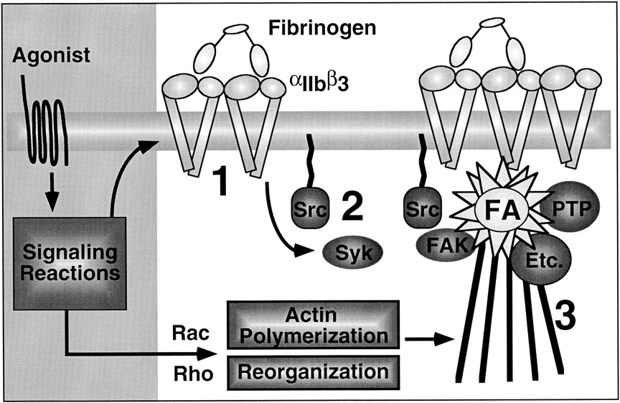
Platelet Activation involves “Outside-In” Signaling
Activation of tyrosine kinases (Src and Syk) promote platelet activation, spreading and aggregation.
Notes:
Platelet activation involves a network of signals coming “in” from “outside.” Signals lead to actin polymerization, bundle formation, attachment to integrins, and ultimately contraction of the platelets and thus the entire clot and wound.

Slide 30
Glanzmann’s Thrombasthenia
Platelets - low number in blood and fail to aggregate
Patients bleed excessively upon wounding, dental work, menstruation. Childbirth can be fatal.
“Classical” Glanzmann’s - mutations in either chain of the platelet fibrinogen receptor glycoprotein IIb/IIIa, or αIIbβ3.
Treatment: Platelet transfusions or bone marrow transplantation.
  Transfusion: Mismatched donor platelets can induce anti-platelet Abs, which exacerbate the problem.
  Bone marrow transplant: Possible graft vs. host disease.
Notes:
Thrombasthenia - “weak” platelets. What is thrombocytopenia?
Mutations affecting platelet integrin (GP IIb/IIIa, aka αIIbβ3). Platelets fail to interact with fibrinogen and thus fail to aggregate.

Slide 31
Function of αvβ3 - the “other” β3 integrin
Osteoclasts- critical for adhesion to bone and bone resorption
Vascular endothelium- proliferation and survival of vascular endothelial cells during pathologic angiogenesis
Tumor cells - adhesion, survival, invasion
Macrophages - phagocytosis of apoptotic cells
Neutrophils - extravasation and oxidative burst
Notes:
Platelet integrin includes beta3 subunit. Beta3 associates with a different alpha subunit in other cells, where it also has important functions.

Slide 32
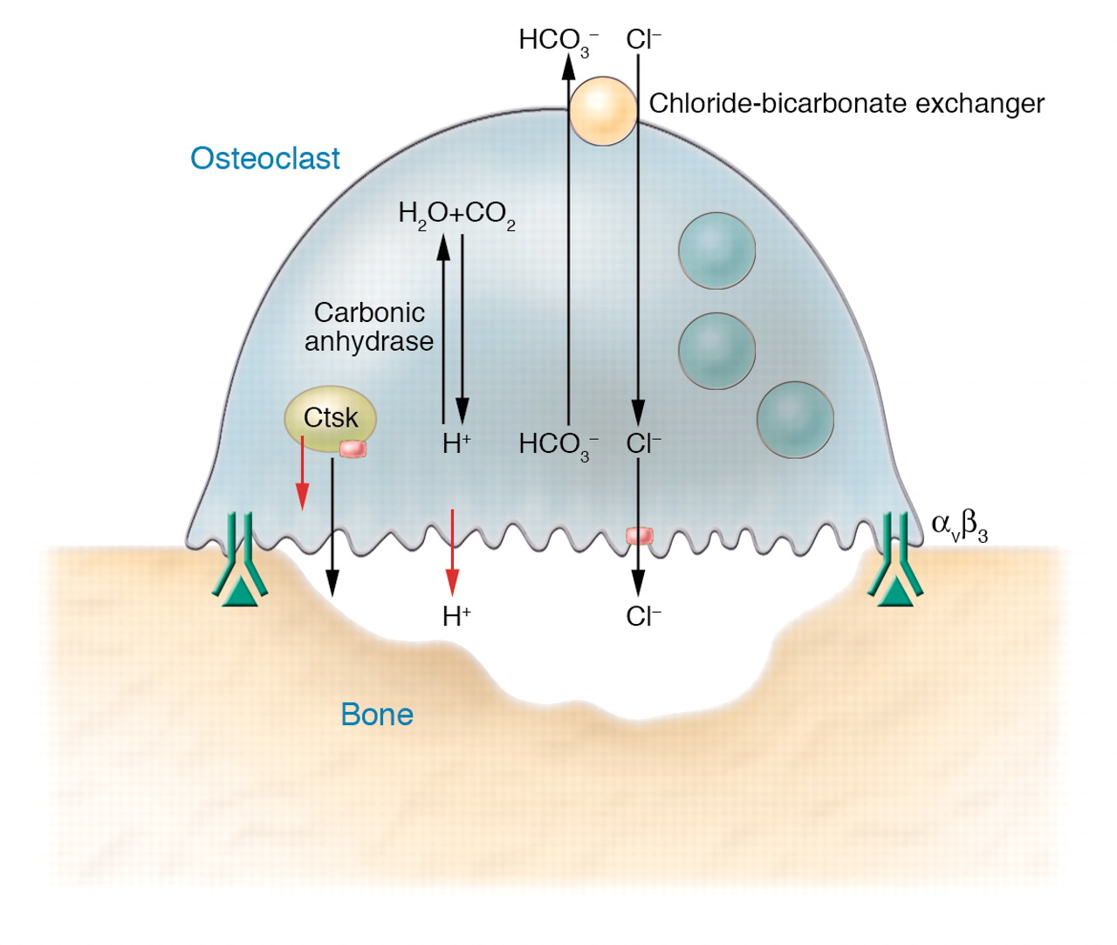
Osteoclasts use Integrin αvβ3
Osteoclast integrin binds to RGD-containing osteonectin on bone matrix. Forms one huge circumferential “focal adhesion” that makes a seal. Cell secretes acid and degradative enzymes to digest the bone.
Notes:
One important specialized cell-matrix adhesion occurs between an osteoclast and the bone that the osteoclast wants to degrade. The cell secretes acid and proteases onto the bone. The cell creates an integrin-based large circular adhesion, and it secretes the acid and proteases only onto the space defined by the adhesion.

Slide 33
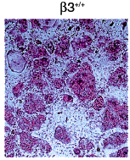
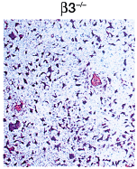

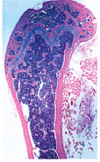
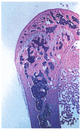
Defective Osteoclasts in Mice Lacking Integrin β3
Wild-type
Mutant
Osteoclasts (big cells): Not large, not spread
Defective Ring of Actin Filaments at the Seal
Marrow Space: Increased Trabecular Bone
McHugh et al. 2000. Mice lacking β3 integrins are osteosclerotic because of dysfunctional osteoclasts. J Clin Invest. 105:433-440.
Notes:
Integrin-deficient (β3-/-) mice have dysfunctional osteoclasts, leading to osteopetrosis. What is “osteopetrosis”? As opposed to “osteoporosis”?

Slide 34
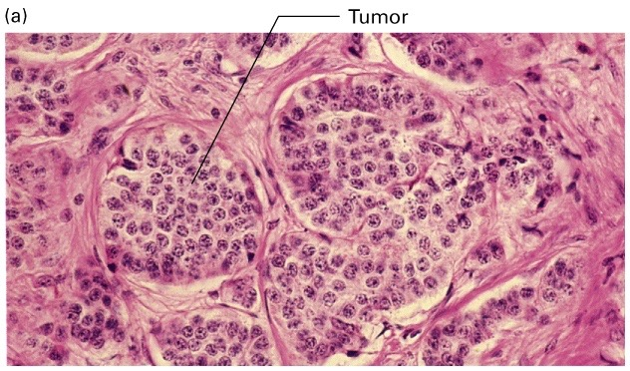
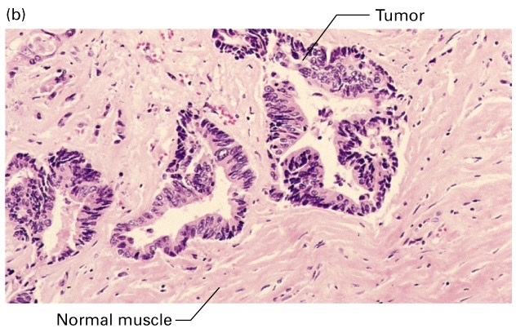
Integrins and Cancer
Fibroblasts and ECM
Left: Benign tumor, surrounded by basement membrane.
Right: Malignant tumor, invading surrounding interstitial tissue.
Notes:
Benign tumors: surrounded / contained by basement membranes.
Breaching the basement constitutes “invasion”, remain localized until the basement membrane is breached.

Slide 35
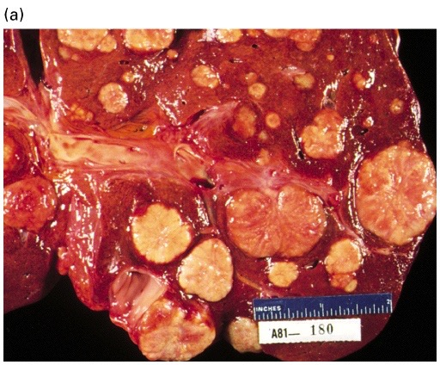
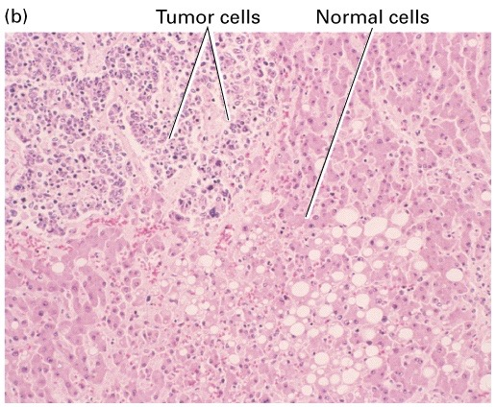
Malignant cancers: Invade surrounding tissue then spread to other organs
Decreased cell-cell interactions, increased protease production, and formation
of new blood vessels. Note absence of basement membrane barriers in (b).
Notes:
Multiple metastatic tumors in a pathology specimen - gross on left, microscopic on right. What organ is this?

Slide 36
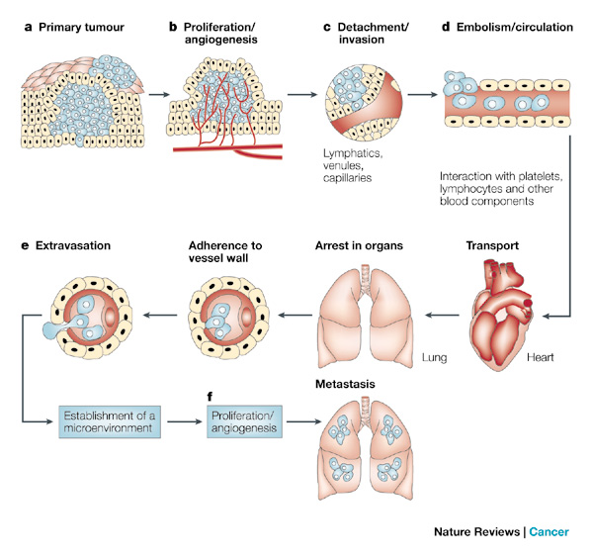
Integrins Have Roles in Many Steps of Metastasis
Fidler, I. J. 2003. The pathogenesis of cancer metastasis: the ‘seed and soil’ hypothesis revisited. Nat Rev Cancer. 3:453-458.
Notes:
The process of metastasis is composed of many steps, nearly all of which involve and depend on integrins.

Slide 37
Proteins Involved in Metastasis
Integrins: Receptors for cell - extracellular matrix (ECM) interactions
Cadherins: Receptors in cell-cell interactions
Matrix Metalloproteases (MMP): Degradation of ECM and adhesion proteins
Growth factors and their receptors
Angiogenic factors: VEGF, FGF.
Transcription factors and their regulators
Notes:
A wide range of proteins, other than integrins, are also involved in metastasis. Many of these proteins are good targets for anti-cancer therapies.

Slide 38
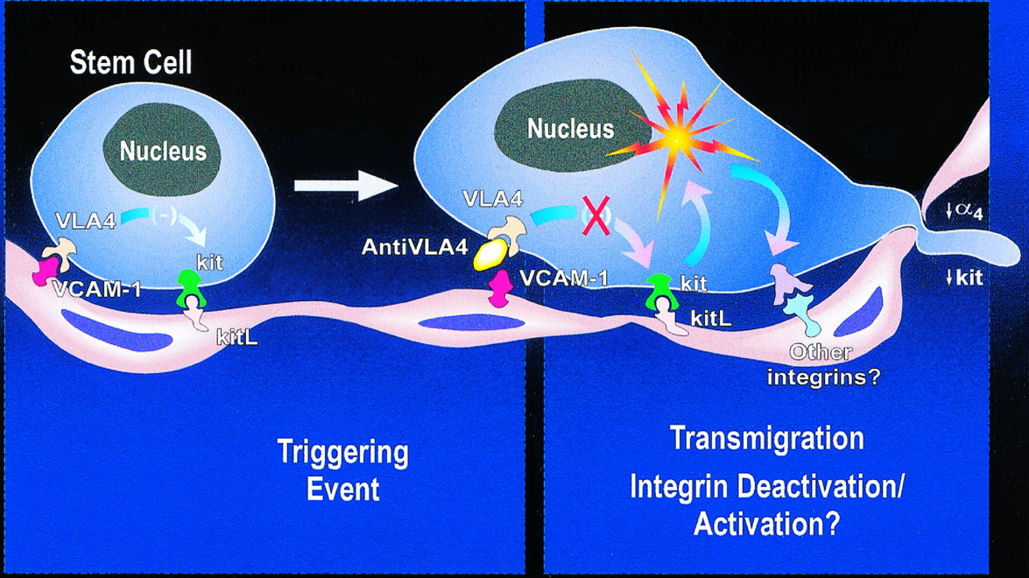
Releasing Stem Cells from the Bone Marrow
Integrin (VLA4) on hematopoietic stem cell (HSC) binds VCAM in bone marrow “niche.”
Receptor (CXCR4) on HSC binds SDF1 on osteoblast / stroma.
G-CSF, α4β1 inhibitors or CXCR4 antagonists disrupt these interactions, releasing stem cells into the circulation, for harvest.
Notes:
Hematopoietic stem cells are held in the bone marrow via a combination of interactions, including integrin-based ones.
Why do you want to release HSCs from the bone marrow?

Slide 39
Therapies with Proteins Targeting Proteins
Receptors, including integrins, are targets for therapies called “biologics”. Biologics are proteins produced by living cells (bacteria, animals, plants). They affect interaction of ligands with cell surface receptors.
These “drugs” pose many challenges in development, delivery, safety and ultimately cost. They challenge the traditional pharmaceutical definitions of “composition” and patentability.
For the companies and FDA, how does one define a biological as “generic”? How does one define and regulate a related molecule?
Notes:
Novel therapies targeting proteins can consist of other proteins, fragments of proteins, or other biological molecules. Challenges conventional notions of how pharmaceuticals are regulated.

Slide 40
Types of Biologics
Ligands
-insulin purified from pig or cow pancreas - early example
-growth factors and hormones produced in animals or cultured cells
Monoclonal Antibodies (mAbs)
-first raised in mice vs human antigens
-now “humanized” to decrease recognition as immune targets
Decoy Receptors
-soluble, extracellular domains of receptors bind ligand in circulation
  -prevents ligand from reaching receptor on cell surface
-examples: soluble VEGF receptor, TNF-α receptor
Nucleic Acid Biologics
-gene therapy (vectors a concern)
-antisense approaches: siRNA, antisense oligos, miRNAs
Notes:
Several examples of “biologics” - therapeutics composed of biological molecules.

Slide 41
Lecture Summary
Cell adhesion molecules have dynamic and essential functions in human physiology, derangements of which often cause disease.
Cell-adhesion molecules (CAMs) involved with structural or surveillance roles are always “ON” - cadherins, mucins and selectins.
Integrins are a class of highly regulatable CAMs. They bind soluble or matrix-bound ligands, including fibrinogen, fibronectin and thrombospondin, as well as cell-associated ligands of the IgG family like I-CAM and V-CAM.
Integrins exists in active and inactive states. Can be activated by inside-out signaling.
Mutations that affect integrin expression, activity and regulation cause a number of human diseases. Integrins are targets of mAbs and other therapeutics.
Biologics are a growing class of drugs that take advantage of the high affinity and selectivity of protein-protein interactions to modify the function of integrins and other cell surface receptors accessible to large macro-molecules.
Notes:
Summary of some of the key take-home messages.

